Slide 1
Developmental Editing
Dr. Faria Altaf
Associate Professor of Dermatology
King Edward Medical College
Mayo Hospital, Lahore

Slide 2
Learning objectives
What is developmental editing
Projects
Scenarios
How do they work together

Slide 3
What is Editing
Carefully reviewing material before it is published
Suggesting or making changes to improve it

Slide 4
Developmental Editing
Developmental editing also called conceptual editing or manuscript appraisal, is a form of writing support that comes into play before or during the production of a publishable manuscript, especially in the area of non-fiction writing

Slide 5
Developmental Editing
An approach that divides the developmental note into three principal sections: structure, narrative, and language
Structure is the container that holds the story, including its length, order and pacing
Narrative is all of the story elements, such as characters, major scenes, continuity, and authenticity
Language includes dialogue, physical description, sensory information, and sentence structure

Slide 6
Importance of Developmental Editing
Writers often struggle with keeping perspective on their own work
They’re too close to it to know what does or doesn’t work for another reader
Writers unconsciously fill in the narrative gaps with their own knowledge of the book
They can be enthralled with their subject, without considering general interest
“It’s about showing the writer what works.”

Slide 7
What it is and isn’t
It denotes significant structuring or restructuring of the manuscript’s discourse
It is not line by line correction

Slide 8
projects
Books
Articles
Dissertations

Slide 9
Beginning a project
You want to talk through new book ideas
You want feedback on book prospectus draft

Slide 10
Stuck in the soggy middle
You’ve written the first half of the book. Now what?
You have a first draft of an article. But you think you have two competing arguments!

Slide 11
Completed but not ready for review
You want feedback about argument, structure, and evidence
You’re not sure which journal is a good fit
You’ve finished the article, but its 2,000 words over the limit

Slide 12
Revise & resubmit
You don’t want to read reviewer reports. Or you have, and you’re in a rage. They can read them for you
You’ve decided to revise, but don’t know how to sort the comments into actionable tasks

Slide 13
Developmental Editing Process
There are a few things that all writers should be clear when considering a developmental edit:
Find a good editor
Be open minded
Be prepared to rewrite
Focus on the big picture
Practice patience

Slide 14
Find a good editor
A few years of experience in the publishing industry
Book editing experience with the genre you’re writing.
Compatible with your personality, understand your writing style, and provide open and honest communication while also respecting your vision.
Knowledgeable about the entire publishing process in order to properly guide you

Slide 15
Focus on the big picture
Developmental editing is comprehensive, and it’s easy to get distracted by the endless small details you want to nit-pick, but there’s plenty of time to do that during the line editing phase
When it comes to developmental editing, the focus should be more about the bigger ideas, and how all the main pieces of the story work together first

Slide 16
Be open minded
Although a necessary step, some authors find it difficult to receive critical feedback on their writing. Sometimes an editor’s critique will involve you cutting out particular moments within your story that you don’t necessarily want to lose.
However, if you find yourself constantly at odds with your editor over your work, it’s possible they might not be the right fit for you

Slide 17
Be prepared to rewrite
A developmental editor may completely shake up the foundation of your manuscript, resulting in a substantial rewrite
You may have to reconsider certain plot elements, characters, settings, or conversations that aren’t telling your story the way you think

Slide 18
Practice patience
Addressing one round of notes from a developmental editor doesn’t mean you’re done, or even close to it.
This editing process is the most involved, and oftentimes changing one part of a manuscript can result in a necessary change elsewhere—but be patient.
It’s worth the time to ensure your manuscript is telling the story you want, and your editor can help you stay on track!!

Slide 20
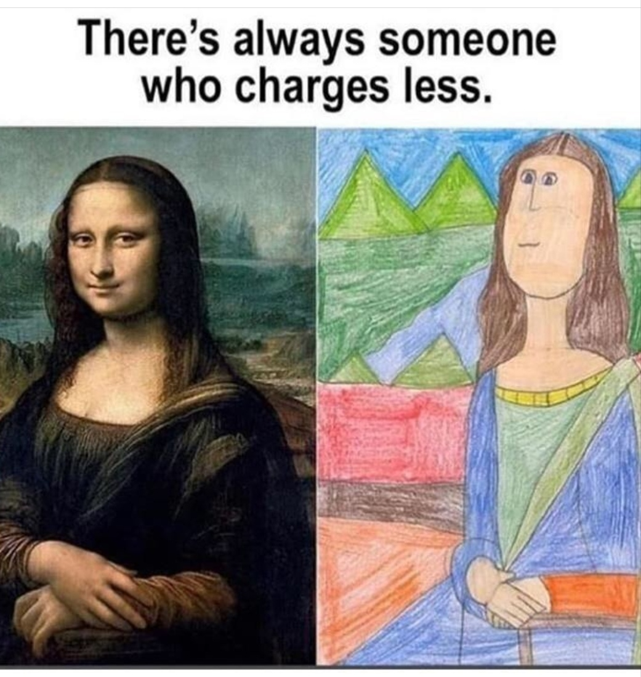

Slide 21
Thank you

