Slide 1
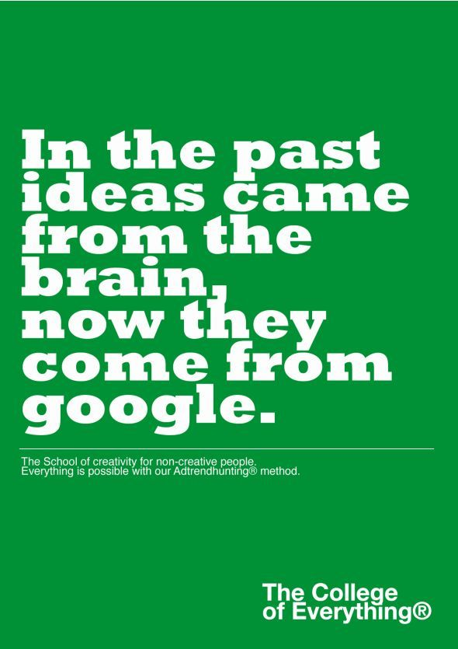

Slide 2
DIRECT PLAGIARISM
Dr. Ghazala Butt
Assistant Professor Dermatology

Slide 3
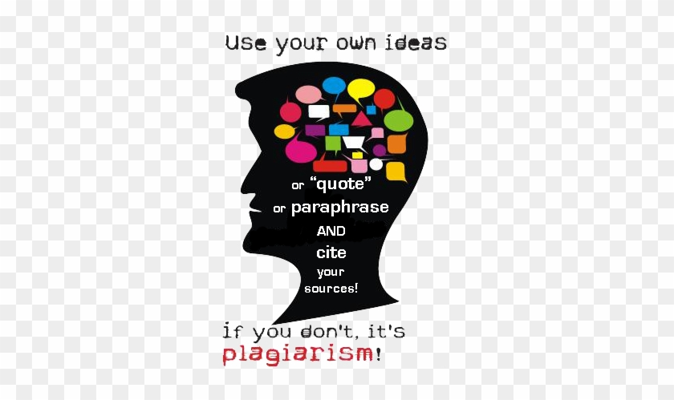
Taken from Internet
Taken from internet

Slide 4
Learning outcomes
At the end of this lecture colleagues will be able to:
Describe direct plagiarism
Enumerate disadvantages of direct plagiarism
Know different examples of direct plagiarism
Describe how to avoid direct plagiarism

Slide 5
Clues for Reviewer/editor to suspect plagiarism

Slide 6
Taken from Internet

Slide 7
Direct Plagiarism
Word-for-word transcription of a section of someone else’s work
without attribution and
without quotation marks
Copying another writer's work with no attempt to acknowledge that the material was found in an external source is considered direct plagiarism.

Slide 8
Source Helios

Slide 9
Explanation
The writer takes most of his or her draft almost word-for-word from another source
The writer uses no quotation marks to distinguish his or her own words from those that are from the source
and she or he provides no citations to acknowledge that the material comes from another source

Slide 10
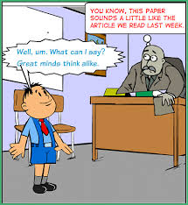

Slide 11
How to avoid Plagiarism
Citation
Paraphrase
Summarize

Slide 12
Taken from Internet
Taken from Internet
Taken from Internet

Slide 13
How to Avoid Direct Plagiarism
Acknowledge that your ideas and/or words came from a source
And either enclose the words taken directly from the source in quotation marks
Or paraphrase the material into your own words. (Note: Paraphrasing is expressing the information from a source with your own words without changing the meaning of the original source)

Slide 14
Seven steps for successful paraphrasing
Read the original a few times
Put the original passage aside – don’t look at it
Take some notes on the main ideas from memory
Write your paraphrase – try rearranging ideas in a different order
Check your paraphrase with the original

Slide 15
Contd..
If there are any phrases that are identical to phrases from the original, either rephrase or put quotation marks around them
Cite your source according to the citation style you are required to use
Source APA

Slide 17
Pitfalls of Direct Plagiarism
The deliberate plagiarism of someone else's work is
Unethical
Academically dishonest
and grounds for disciplinary actions, including expulsion

Slide 18
Student Writer A: Long ago, when there was no written history, these islands were the home of millions of happy birds; the resort of a hundred times more millions of fishes, sea lions, and other creatures. Here lived innumerable creatures predestined from the creation of the world to lay up a store of wealth for the British farmer, and a store of quite another sort for an immaculate Republican government. | Source: "In ages which have no record these islands were the home of millions of happy birds, the resort of a hundred times more millions of fishes, of sea lions, and other creatures whose names are not so common; the marine residence, in fact, of innumerable creatures predestined from the creation of the world to lay up a store of wealth for the British farmer, and a store of quite another sort for an immaculate Republican government."
Taken from internet

Slide 19
Contd..
Writer A has included a word-for-word passage from another source without any indication that it is a direct quotation.

Slide 20
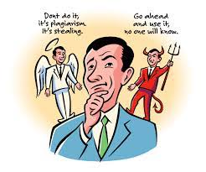

Slide 21
Student Writer A: Long ago, when there was no written history, these islands were the home of millions of happy birds; the resort of a hundred times more millions of fishes, sea lions, and other creatures. Here lived innumerable creatures predestined from the creation of the world to lay up a store of wealth for the British farmer, and a store of quite another sort for an immaculate Republican government. | Source: "In ages which have no record these islands were the home of millions of happy birds, the resort of a hundred times more millions of fishes, of sea lions, and other creatures whose names are not so common; the marine residence, in fact, of innumerable creatures predestined from the creation of the world to lay up a store of wealth for the British farmer, and a store of quite another sort for an immaculate Republican government."
Taken from internet

Slide 22
Contd..
Writer A has included a verbatim passage from another source and has failed to indicate it's a direct quotation.

Slide 23
Plagiarism creates an environment of
Miscommunication
Betrayel
Distrust
Lack of integrity

Slide 24
How to detect a Plagiarized Work
Clues
Mixing styles of citation
Very few citations,quotations
Dead end references “See Table 4”
Mixed styles:Margins,subheadings etc
Off the topic in an odd way
Dated info
Dead URLs in citations
Funny styles: too technical or old-fashioned

Slide 25
Taken from internet

Slide 26
BE ORIGINAL
&
DON’T PLAGIARIZE

