Slide 2
Proofreading
Dr. Shehla Shaukat
Associate Professor
Dermatology Unit-I
KEMU/ Mayo Hospital
Lahore

Slide 3
Learning Outcomes
Differentiate between editing and proofreading
Rules and confusions of proofreading
Symbols and abbreviations used in proofreading

Slide 4
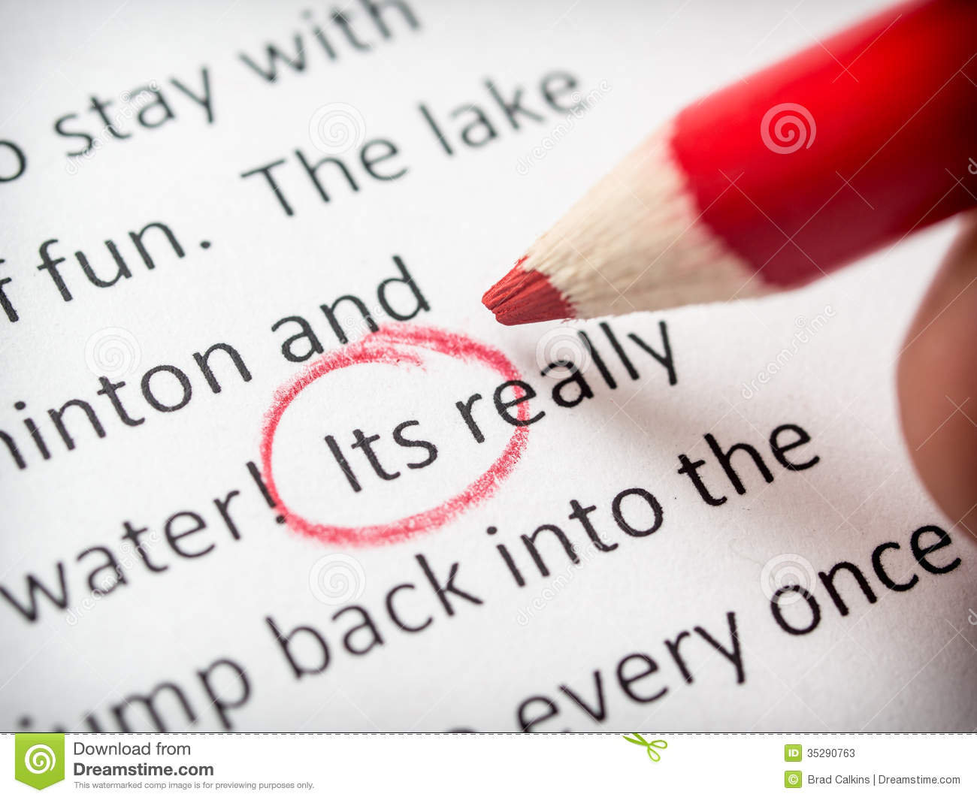
Proofreading is the process of reviewing the final draft of a piece of writing to ensure:
Accuracy
Spelling, grammar, punctuation, etc.
Impression
Tense, tone, intent
Professionalism
Overall appearance, clarity, conciseness

Slide 5
Difference between Revising, Editing and Proofreading

Slide 6
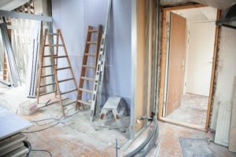
Revising
Revising is done throughout the writing process, with special emphasis on the first few drafts by the author.
Focus = big issues
Audience
Organization
Content
Evidence
Conclusion

Slide 7
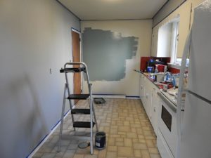
Editing
Editing is done throughout the writing process, with special emphasis on the middle and final drafts.
Focus = technical issues
Flow
Word choice
Grammar
Transitions
Textual inconsistencies

Slide 8
Proofreading
Proofreading is reserved for the final draft.
Focus = mechanics and presentation
Spelling
Punctuation
Format
Typographical errors (“typos”)

Slide 10
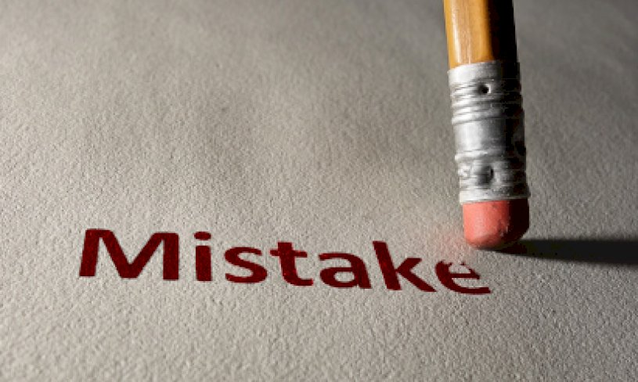
Requirements for a proofreader
Attentiveness for details.
In-depth knowledge of the English language.
Excellent written and oral communication.
Ability to meet deadlines.
Familiarity with digital tools.
List of links to valuable tools:
Microsoft Word, ProWritingAid, Grammarly, Marian Webster‘s Dictionary, The Chicago Manual of Style, Editorial Freelancers Association.

Slide 11
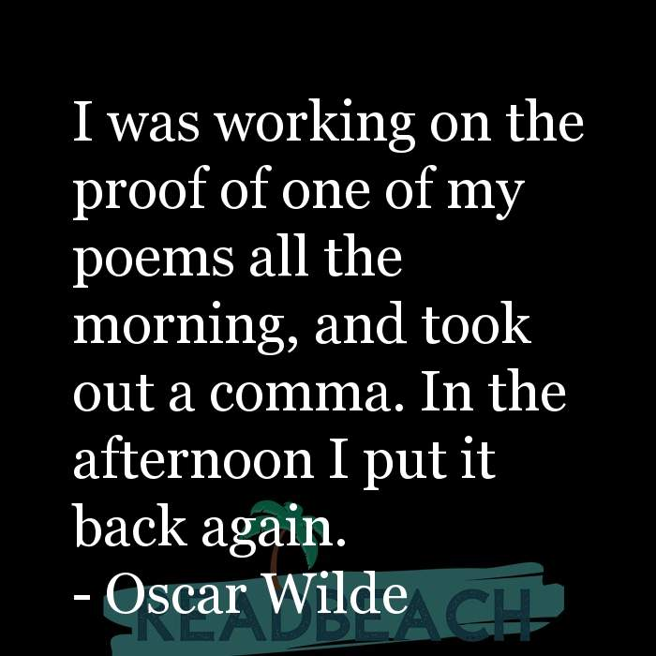
Strategies of proofreading
Read paper slow and out loud.
Use a ruler or blank sheet for sentence lines.
Highlight every punctuation mark.
Use the search function.
Track frequent errors.
Remember to proofread only one kind of error at a time.
Use an automatic grammar spelling checker in the end.
Try reading the text backward.

Slide 12
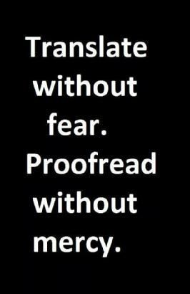
Rules

Slide 13
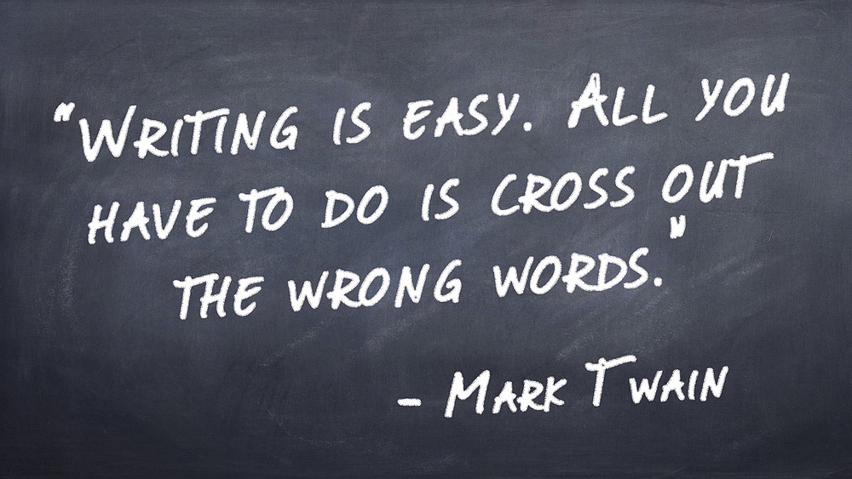
Word choice
Use specialized language
Be concise
No slangs
Grammar
Every sentence should contain all the grammatical elements including subject, verb and object
The subject and verb should agree in a sentence
Nouns and pronouns should match

Slide 14
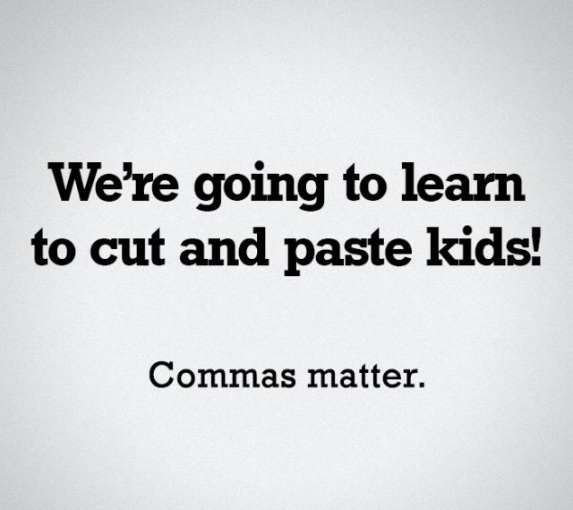
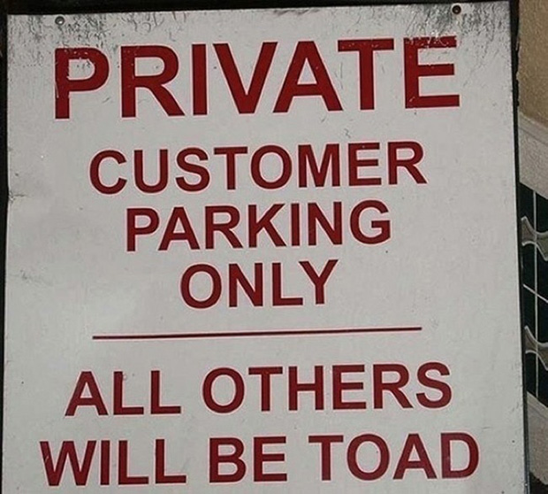
Punctuation
Use punctuation correctly in a sentence
Use commas at right places
Use apostrophes for right reasons
Spellings
Use a spell checker but don’t just rely on it
Learn the spellings of the words you use often

Slide 15
Tense of the sentences
Abstract – past tense
Introduction – present tense
Review – past tense
Methodology – past tense
Results – past tense
Discussion – present tense
Conclusion – present tense

Slide 16
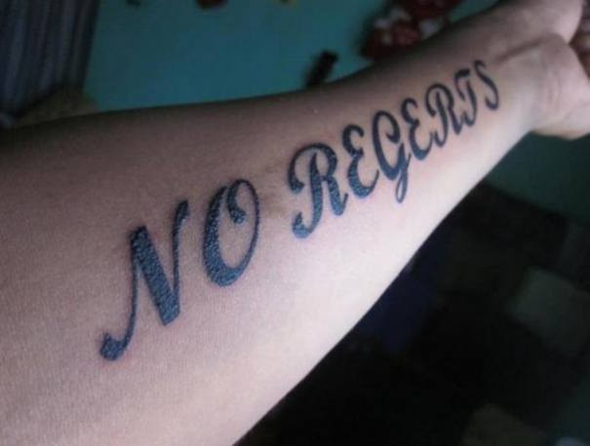
Confusions

Slide 17
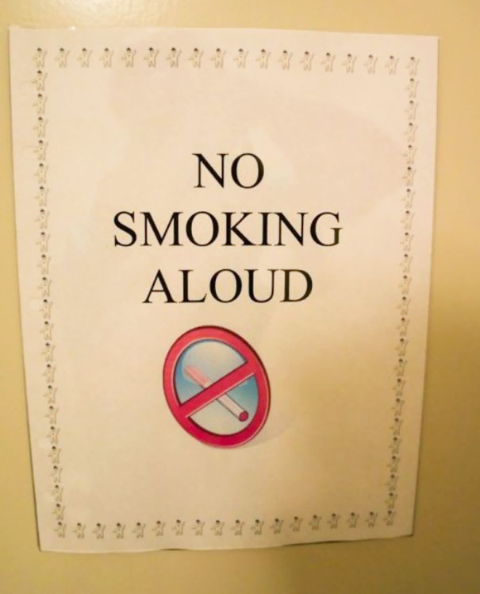
Spelling and word choice confusions
Confusions between homophones (e.g. there/they’re/their)
Misuse of definite and indefinite articles (the/a/an)
Misuse of prepositions

Slide 18
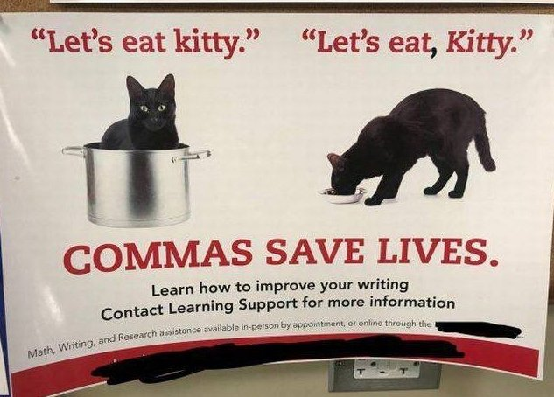
Misplaced punctuation
Missing or misused commas
Confusion between hyphens, em dashes and en dashes
Incorrect use of apostrophes
The longer em dash (—) is used to separate extra information or mark a break in a sentence.
Dark, leafy greens—such as spinach, kale, and chard—are an important part of a healthy diet.
The shorter en dash (–) is used to mark ranges.
The company had a successful 2018–2019 fiscal year.

Slide 19
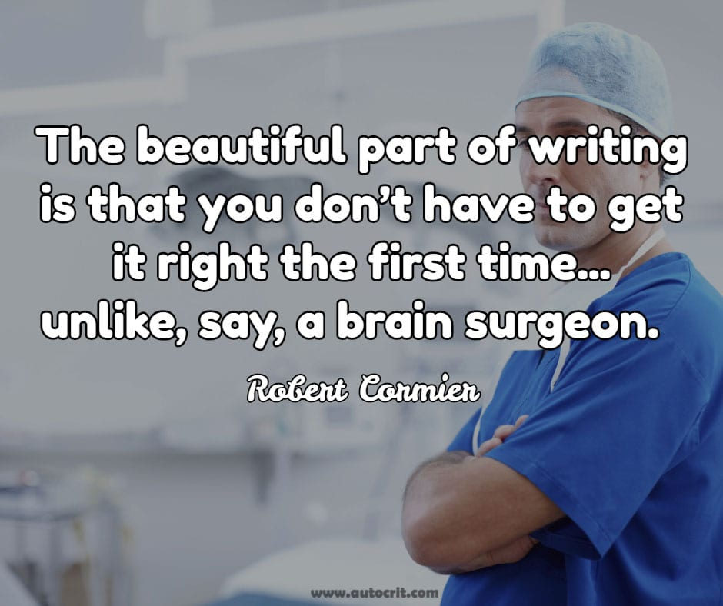
Stylistic inconsistency
Switching between UK and US conventions
Inconsistent capitalization of terms or titles
Inconsistent treatment of numbers

Slide 20
Formatting issues
Incorrect formatting of quotations and citations
Inconsistent paragraph indentation and spacing
Missing or misplaced page numbers, headers and footers

Slide 21
The Proofreader’s Tools

Slide 22
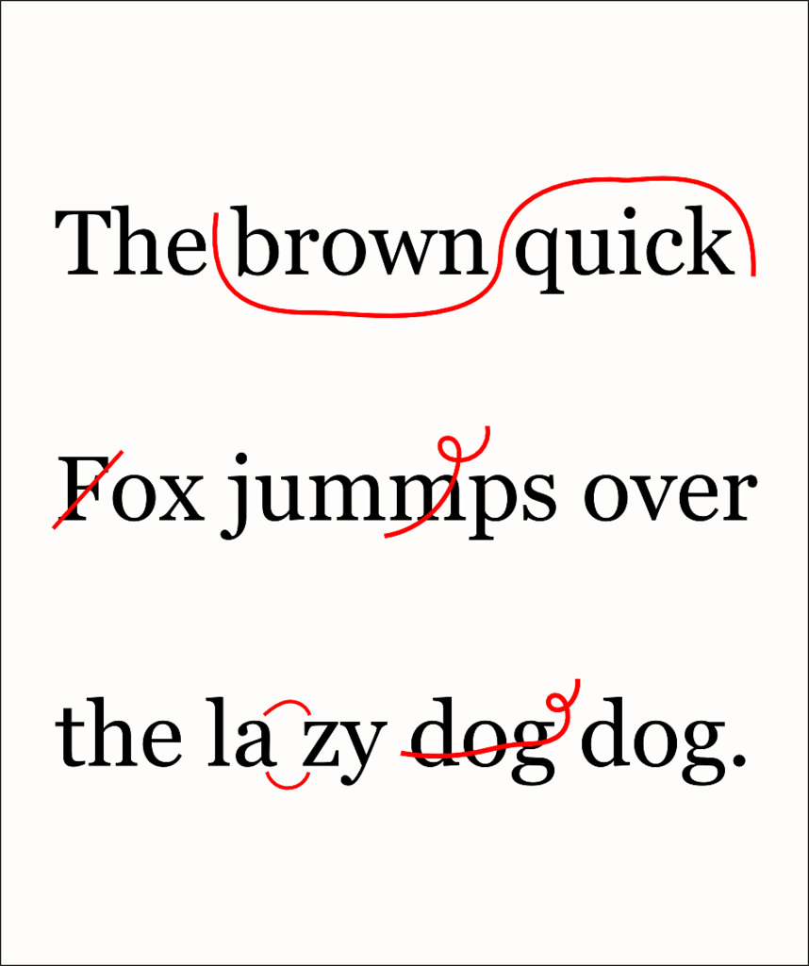
Dictionary
Thesaurus
Grammar book
Red pen
Lack of fear

Slide 23
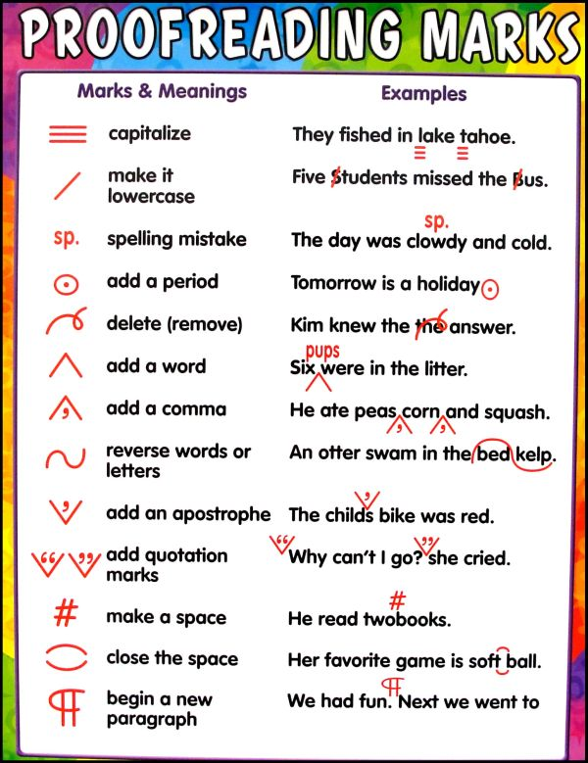
Common Proofreading Symbols

Slide 24
Common Proofreading Abbreviations
Abbreviation | Meaning | Example
Ab | Faulty abbreviation | She had earned her Phd along with her M.D.
Agr | Agreement problem Subject/verb | A basket of puppies were in the kitchen.
Awk | Awkward expression or construction | The past month has seen two major developments.
Cap | Faulty capitalization | We spent the Fall in Southern spain.
CS | Comma splice | The project ran over the deadline, data processing was extensive.
DICT | Faulty diction | The boy whose has fell off the bicycle has hurt his leg
Dgl | Dangling construction | Entering the room, the light was off.
-ed | Problem with final -ed | Last summer he walk all the way to London.

Slide 25
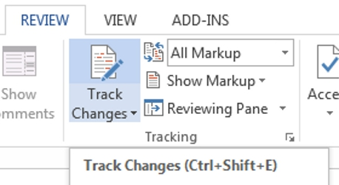
Edit on the Computer and Track Changes
Editing on the computer screen is much effective.
Track Changes feature - it is in all the text editors.

Slide 26
Tips and Tricks

Slide 27
DO’s:
Repeat process of proofreading more than once
Look for typing, grammatical, spelling and punctuation errors
Pay attention to frequently misspelled, typed incorrectly or misused words
DON’Ts:
Proofread during editing and writing process
Proofread only certain part of the document
Spend too much time on the proofreading process

Slide 28
Exercise 1: Find the error in each sentence
1. These results indicate that Drug X is more effective then placebo in reducing symptoms in patients with diabetes.
2. We showed that this method is more percise than the current standard diagnostic tools.
3. Tools are available for physicians to assist them in the management of the patient and they’re disease.

Slide 29
Exercise 2: Find the errors in each sentence
1. More than ≥50% of patients expereinced treatment-emergent adverse events, the most common of which was headache, nausea and dizziness.
2. Healthy males and women aged between 18 or 35 years with a total body wait of 50kg were enroled in the study.
3. The incident rate ration (IRR) for diarrhia was 0.91 (95% confidence interval [CL]: 0.21–3.22) for treatment with drug A, 0.90 (95 CI: 0.63–1.11) for drug b, and 2.85 (95% CI: 0.65-8.35) for drug C.

Slide 31
ANSWERS:
Exercise 1: The errors are underlined.
1. These results indicate that Drug X is more effective then placebo in reducing symptoms in patients with diabetes.
2. We showed that this method is more percise than the current standard diagnostic tools.
3. Tools are available for physicians to assist them in the management of the patient and they’re disease.
Exercise 2: The errors are underlined.
1. More than ≥50% of patients expereinced treatment-emergent adverse events, the most common of which was headaches, nausea and dizziness.
2. Healthy males and women aged between 18 or 35 years with total body wait of 50kg were enroled in the study.
3. The incident rate ration (IRR) for diarrhia was 0.91 (95% confidence interval [CL]: 0.21–3.22) for treatment with drug A, 0.90 (95 CI: 0.63–1.11) for drug b, and 2.85 (95% CI: 0.65-8.35) for drug C

