Slide 1
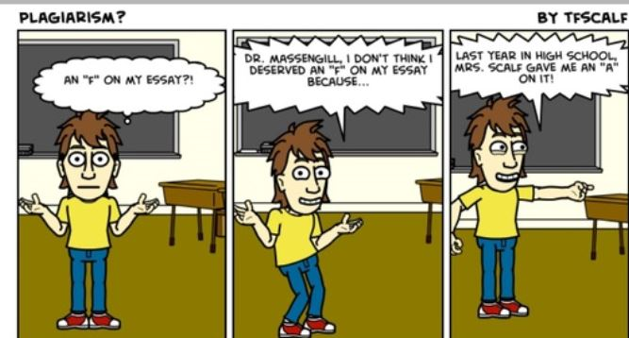

Slide 2
SELF PLAGIARISM
DR FATIMA NAUMERI
ASSOCIATE PROFESSOR PEDIATRIC SURGERY DEPARTMENT, KEMU

Slide 3
DISCLOSURE
Nothing to disclose

Slide 4
TEST CASE
DR Z is an expert in congenital diaphragmatic hernia and has published 3 papers on the topic. She plans to write a review article and uses some text from her previous publications. She should:
Keep her text verbatim
Paraphrase her original text
Change a few words and cite her text
Use her text within quotes and cite her text¹

Slide 5
LEARNING OUTCOMES
At the end of lecture, the participants would be able to
Define self plagiarism
Identify self plagiarism and it’s types
Enlist the norm (prevention) and remedy for self plagiarism
Know editors’ perspectives

Slide 6
definition
PLAGIARIUS:
Latin word “kidnapper or kidnapping, theft or a thief of ideas” (McArthur 1992:784)
PLAGIARISM:
“ The appropriation of another person’s ideas, processes, results, or words without giving appropriate credit” (OSTP 2000)²

Slide 7
DEFINITION
SELF PLAGIARISM:
“Republishing substantive parts of one’s own earlier publications, including translations, without duly acknowledging or citing the original.”
(European Science Foundation 2017)³
Linguistic plagiarism
Text recycling
“Cryptomnesia”

Slide 8
TYPES OF SELF PLAGIARISM
Dual/ Duplicate publications
New publication with little addition to previous one
Redundant publications
Reanalysis of previous published data set²⁻⁴

Slide 9
TYPES OF SELF PLAGIARISM
Segmented publications
Salami slicing of data set for different publications
Text recycling
Cloning without proper reference²⁻⁴

Slide 10
Identification of self plagiarism
Inappropriate self citation
Consecutive reproduction
Foreign language
Detection by soft-wares^{3,4}

Slide 11
SOFT WARES
Déjà vu
eTBLAST
CrossCheck
WCopyfinal
SPlaT
Turnitin
iThenticate
Visual mapping software (VOS)

Slide 13
PREVENTION
Educate about research misconduct
Self cite
Follow COPE guidelines
Copyright guidelines^{3,4}

Slide 14
NORM
“Quotation marks if more than 6 words are copied”
Justified when longitudinal study over many years, republishing abstract, doctoral thesis related publications (http://publicationethics.org/case/previous-publication)^{2,3}

Slide 15
“Once you have transferred copyright to a journal (in order to publish) you can’t ethically use the words that you have written in another journal article; you no longer own those words.”⁵
GENNARO 2012 p 109

Slide 16
IMPLICATIONS
Copyright violation
Legal action
Defamation and academic fraud
Undue editorial load, peer process⁴

Slide 17
REMEDY
Revise manuscript
Withdraw the manuscript
Retract the manuscript
Rejection³

Slide 18
REAL LIFE EXAMPLE
JONAH LEHRER
Jonah Lehrer recently resigned as a writer for the New Yorker after he was caught self-plagiarizing on a number of occasions and fabricating quotes for a book.

Slide 19
EDITORS’ PERSPECTIVE
Since 1990-2015: 57 editorials in Scopus/ WoS and 75 reports in COPE
ICMJE duplicate submission/publication, acceptable secondary publication, manuscript based on same data set
Is self plagiarism a failure to self cite only?
Is rehashing work in various linguistic contexts self plagiarism?
Is redundant publication/ salami slicing a form of self plagiarism?³

Slide 20
REFERENCES
Burdine LK, de Castro Maymone MB, Vashi NA. Text recycling: Self-plagiarism in scientific writing. Int J Women’s Dermatology [Internet]. 2019;5(2):134–6. Available from: https://doi.org/10.1016/j.ijwd.2018.10.002
Bruton S V. Self-Plagiarism and Textual Recycling: Legitimate Forms of Research Misconduct. Account Res. 2014;21(3):176–97.
Lin WYC. Self-plagiarism in academic journal articles: from the perspectives of international editors-in-chief in editorial and COPE case. Scientometrics [Internet]. 2020;123(1):299–319. Available from: https://doi.org/10.1007/s11192-020-03373-0
Arumugam A, Aldhafiri FK. A researcher’s ethical dilemma: Is self-plagiarism a condemnable practice or not? Physiother Theory Pract. 2016;32(6):427–9.
Callahan JL. The retrospective (im)moralization of self-plagiarism: Power interests in the social construction of new norms for publishing. Organization. 2018;25(3):305–19.

Slide 21
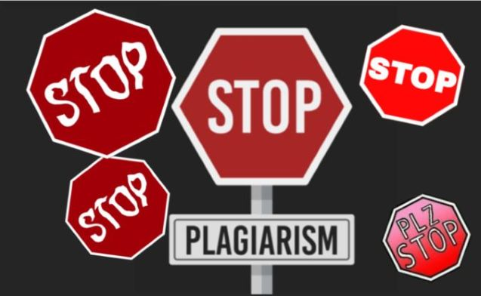
THANK YOU!
Any Questions? Case test answer (4)

