Slide 1
COPE GUIDELINES on PLAGIARISM
Dr. Romaisa Shamim Khan
Assistant professor
Plastic Surgery

Slide 2
AIM
To be able to implement the COPE guidelines correctly on various scenarios of plagiarism
To meet this aim
Define plagiarism
Know the existing COPE guidelines that relating to plagiarism
Have an understanding of COPE’s recommendations on different scenarios

Slide 3
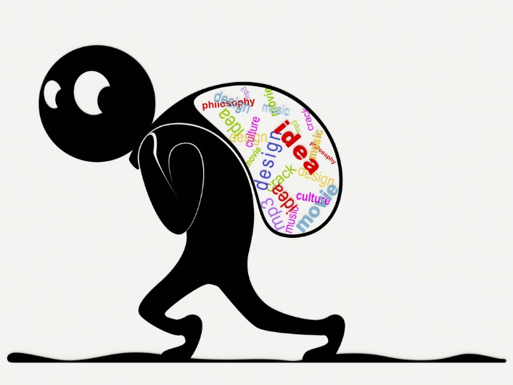
Definition of plagiarism
presenting someone else's work or ideas as your own, with or without their consent, by incorporating it into your work without full acknowledgement
Committee on publication ethics (COPE) recommends that instructions to authors must include
A definition of plagiarism
Journal’s policy on plagiarism

Slide 4
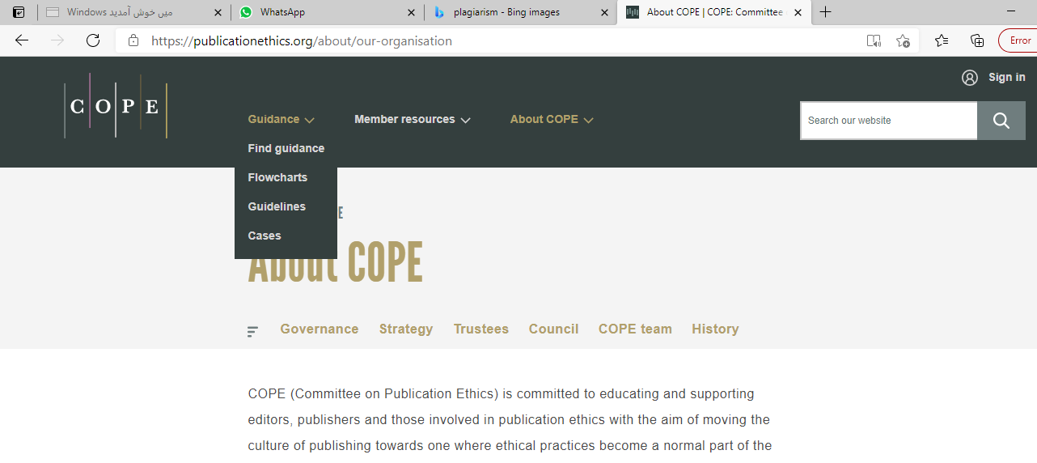
COPE guidelines - overview

Slide 5
Cope guidelines - overview
COPE provides guidance for 3 different scenarios on plagiarism
Suspected plagiarism in a submitted manuscript
Plagiarism in a published article
Text recycling guidelines (Self-plagiarism)

Slide 6
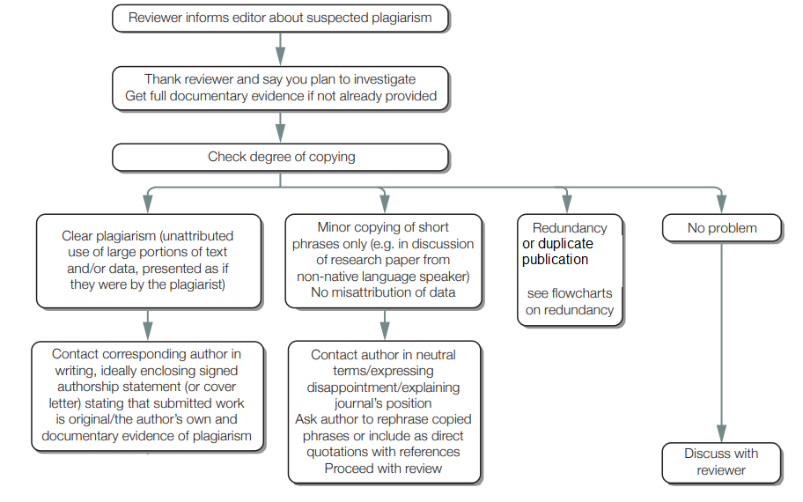
Suspected plagiarism in submitted manuscript (flowchart)

Slide 7
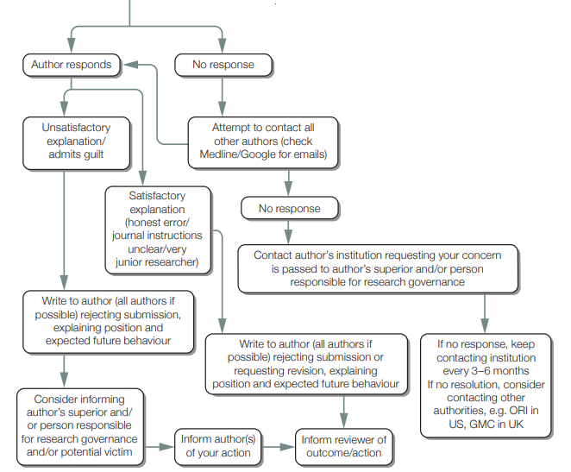
(flowchart continued) After contacting author:

Slide 8
Plagiarism in published article (flowchart)
reader will get in touch with the editorial team regarding plagiarism in published article

Slide 9
Flow chart continued for ‘clear plagiarism’

Slide 10
Text recycling - guidelines
Text recycling, or self-plagiarism occurs when sections of the same text appear (usually unattributed) in more than one of an authors own publications.
Not to be confused with REDUNDANT or DUPLICATE publication, a more serious problem of repeated publication of ideas or data, often with one common author
Text recycling can occur in
submitted manuscripts
published articles

Slide 11
How can editors deal with text recycling
Consider each case on an individual basis
Determine the ‘significance’ of overlap based on the following factors
How much text is recycled?
Where in the article the text recycling occurs?
Whether the article is a research or non-research article
Whether the source of the recycled text has been acknowledged

Slide 12
For research articles
Introduction/background
Some degree of recycling is unavoidable, especially if an article is one of several on a related topic
overlap in background ideas less significant than overlap in hypothesis
Editors should determine if the original source is cited
Methods
Use of similar phrases in methods may be unavoidable when using a technique that the author has described before. It may actually be of value when the technique in question is common to a number of papers
Editors should use their knowledge of the field when deciding how much text overlap is acceptable
An important factor to consider is whether the authors have been transparent, stating that the methods have already been described elsewhere

Slide 13
Results
almost always unacceptable
consider whether this is a redundant publication
Deal according to COPE guidelines for redundant publication
Occasionally, authors may have legitimate reasons to include their previously published data e.g, reporting an extension of previous research
In such cases, this duplication must always be reported transparently and becompliant with copyright requirements
Discussion
Some degree of text recycling may be acceptable
Large amounts: NOT acceptable
Majority of the discussion should focus on putting the results of the current study in context

Slide 14
Conclusion
Text recycling is unlikely to be acceptable
Editors should consider whether the content of the article is novel.
Figures and tables
Reproduction of previously published figures or tables may represent data duplication
if the authors do not provide a justification and, if reproduced without permission, may result in copyright infringement.

Slide 15
NON-research articles
Opinion, review and commentary articles
Should, in principle, adhere to the same guidelines as research articles
Due to opinion-based nature of some non-research article types, editors should consider asking for an explanation and/or taking action
when text is recycled from an earlier publication without any further novel development of previously published opinions or ideas
when they are presented as novel without any reference to previous publication

Slide 16
When should action be considered for TEXT-RECYCLING
When significant overlap is identified between two or more articles, editors should consider asking for clarification and/or taking action

Slide 17
What action should be taken if text recycling is discovered
Text recycling in submitted manuscript
Minor
ask authors to rewrite sections
Major
May result in rejection of manuscript
Overlap in data/results
Constitues redundant publication
deal according to COPE flowchart for redundant publication in submitted manuscript

Slide 18
Text recycling in published paper
Correction
Sections of the text are near identical to a previous publication by the same author(s) but
There is sufficient new material to justify its publication
The correction should amend the literature by adding any missing citation and clarifying what/where the overlap was
Retraction
There is significant overlap in the text, in multiple sections, without addition of new material
The recycled text reports previously published data, i.e. redundant publication
deal according to COPE flowchart for suspected redundant publication in a published article
The overlap breaches copyright. If this is the case then legal advice is needed
Retraction should follow COPE retraction guidelines

Slide 19
Conclusion
Editors should be familiar with the available COPE guidelines on plagiarism
Should be able to use the guidelines and flowcharts to make correct decisions when faced with such scenarios
Responsibility on the editors, especially where major plagiarism/breach of confidentiality is detected

Slide 20
references
Suspected plagiarism in a submitted manuscript | COPE: Committee on Publication Ethics
Plagiarism in a published article | COPE: Committee on Publication Ethics
Text recycling guidelines for editors | COPE: Committee on Publication Ethics

