Slide 1
Clone Plagiarism
By- Dr Maria Imran
Assistant Professor Gyne Unit II
Lady Willingdon Hospital/KEMU

Slide 3
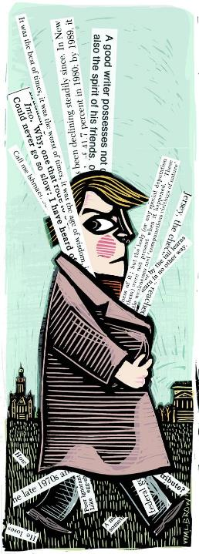
Objectives
Undertand plagiarism espcially clone and its importance
How to detect it
Ways to prevent it
Impact on editors

Slide 4
Introduction
Plagiarism is using someone else’s work or ideas without attributing proper credit and presenting the work or ideas as your own.
Considered an academic violation
Though not illegal in a criminal or civil sense.
When someone commits plagiarism, the act is against the author of the work.

Slide 6
Clone Plagiarsim
Act of taking someone else's work, word-for-word, and submitting it as your own
Often seen in schoolwork submitted by students
On websites that scrape content from reputable websites and paste it on their own site as though it were their own writing

Slide 7
Example
writer has taken a passage from the original work, cut and paste it word-for-word, and made it seem as though it was their own

Slide 8
Consequnecs of Clone Plagiarism
Student reputation can be destroyed
Professional reputation can be destroyed
Academic reputation may be destroyed
Legal repurcussions
Monetary repurcussions
Plagiarized research could be henious

Slide 9
Detection Tools
Most common and problematic form of plagiarism.
Several paid and free detection tools are available
Available online as well as installed software
Easy to use and very accurate
Detect plagiarism efficiently

Slide 10
Free Plagiarism tools
Dupli checker
iThenticate/Crosscheck
Plagiarism detector
Paper rater
Plagiarsima

Slide 11
Paid Plagiarism Tools
Grammerly
Turnitin
Plagiarism checker X
Copyscape
Copyleaks

Slide 12
Prevention
Keep track of the sources you consult in your research
Paraphrase and quote from your sources (add your own ideas)
Credit the original author in and in-text citation and reference list
Use a plagiarism checker before you submit.

Slide 14
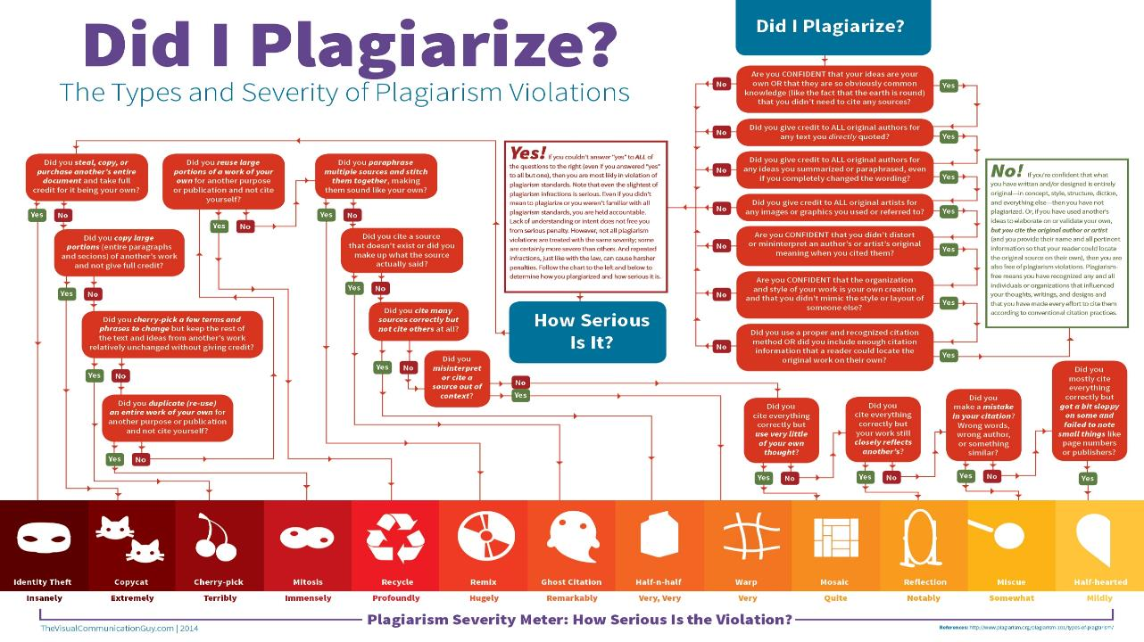

Slide 16
Clone plagerism thru Editor’s lens
To devise workable policies for both submitted and published articles, editors will need to consider the thresholds for deciding when to:
educate authors and ask them to rewrite copied text
reject an article
issue a correction (for a published article)
issue a retraction (for a published article)
inform an author’s institution

Slide 17
Factors affecting severity of Plagiarism
extent
originality of copied material
position / context
referencing / attribution
intention
author seniority
language

Slide 18
Major plagiarism
Major plagiarism could be defined as: Any case involving
unattributed copying of another person’s data / findings, or
resubmission of an entire publication under another author’s name (either in the original language or in translation), or
verbatim copying of >100 words of original material in the absence of any citation to the source material, or
unattributed use of original, published academic work, such as the structure, argument or hypothesis/idea of another person or group where this is a major part of the new publication and there is evidence that it was not developed independently.

Slide 19
Major plagiarism in submitted article –
Present findings to all authors and ask them to respond;
Ask the authors if all or only some of them are responsible for the plagiarised sections,
Decide if any authors were unaware of the plagiarism
Explain that plagiarism is unacceptable and that you plan to inform their institution;
Contact the institutions of authors you consider were directly involved with, or should take responsibility for, the plagiarism
Major plagiarism in published article – as for submitted article, then retract article

Slide 20
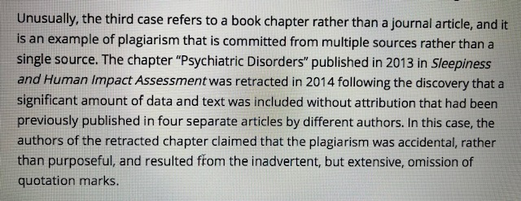

Slide 21
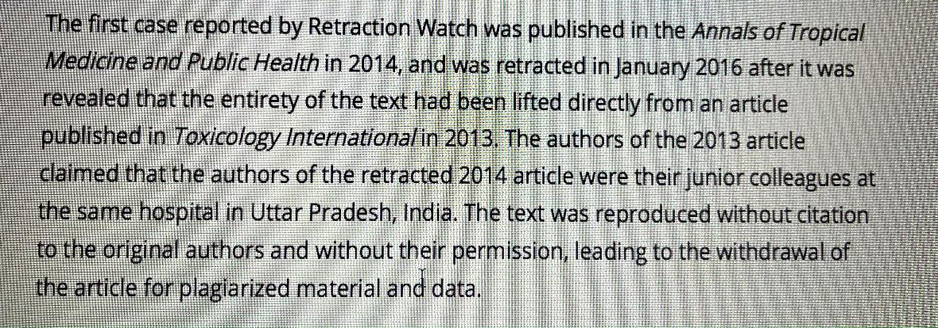

Slide 22
Take Home Message
Clone Plagiarism is a serious kind of plagiarism
All steps to prevent it must be taken while doing scientific writing
Tools to detect plagiarism are efficient and must be used
Editors must device plagiarism policies to ensure authentic publishing

Slide 25
Thank You

