Slide 1
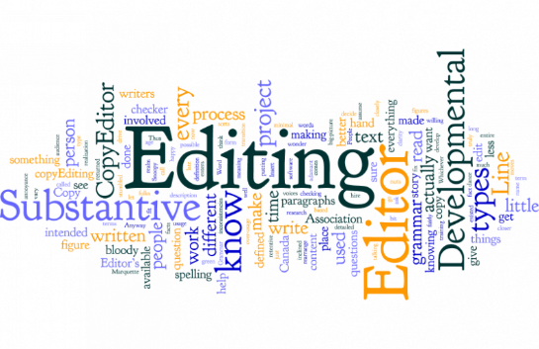
copy Editing
DR. WAJIEHA SAEED
Assistant Professor Dermatology
KEMU/ Mayo Hospital

Slide 2
Can a paper get rejected in the copyediting phase?

Slide 3
LEARNING OUTLINES
What is copy editing?
What is the importance of it?
What are the different types of copy editing?
Who does copy editing?
What are the responsibilities of copy editor?

Slide 4
Success of a journal depends on timely response to manuscript
submission, to acceptance, to editing, to publication of high quality
material.
Editing is to ensure that all material for publication is presented to
the highest standard and conforms with the house style

Slide 6
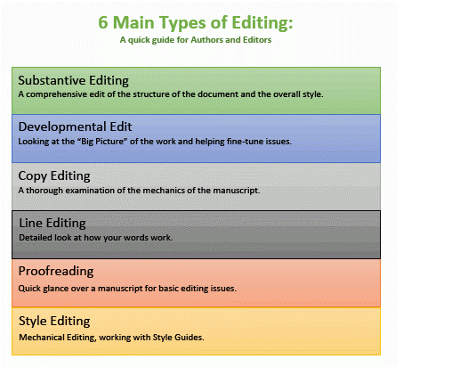

Slide 7
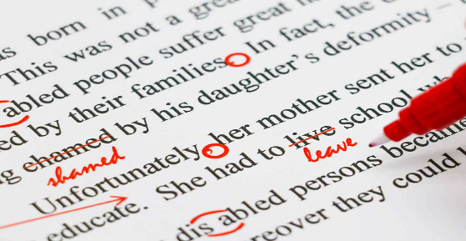
Copy Editing
Process of revising written material to improve readability,
consistency, as well as ensuring the text is free of grammatical
and factual errors.
Editing focuses on the meaning of written content
Copyediting focuses on its technical quality

Slide 8
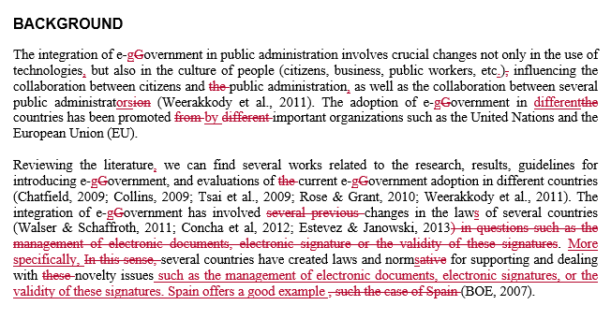
EXAMPLES OF COPYEDITING

Slide 13
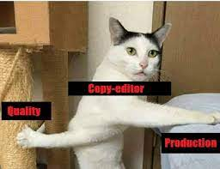
TYPES OF COPY EDITING
Line Editing
Fact-Checking
Rewriting
SEO Copy Editing
Proofreading
Content Refreshing

Slide 14
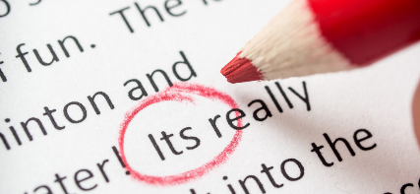
Line Editing
Process of assessing the piece of work as a whole
Considering it’s clarity, accuracy, tone, consistency, and
overall effectiveness
Fact-Checking
More straightforward type of copy editing
It involves ensuring all facts are accurately and appropriately
attributed according to the publisher’s style requirements

Slide 15
Rewriting
Involves reconstructing a portion or all of a written piece
SEO Copy Editing
For search engine optimization SEO
Creating useful, compelling, and valuable content that targets
specific keywords so that other people will gladly promote it on
social media platforms

Slide 16
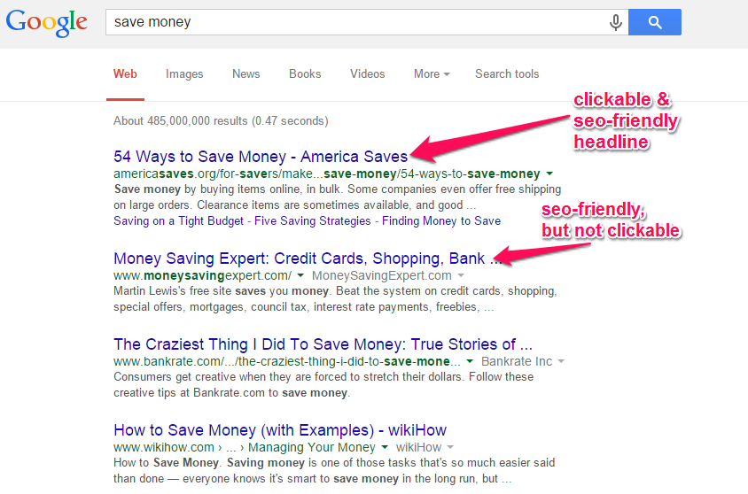

Slide 17
Proofreading
Process of checking grammatical accuracy of written content
Ensuring correct spelling, capitalization, punctuation,
formatting, noun-pronoun agreement, verb usage and
sentence structure
Just one or two errors might cause a reader to question the
credibility and validity of your work

Slide 18
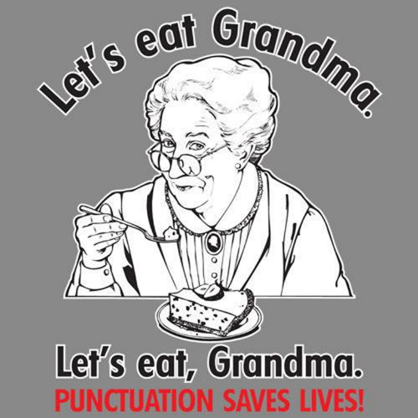

Slide 19
Content Refreshing
Involves a simple content review to check for a stale or
outdated tone of voice, inaccurate or changed information,
and other out-of-date copy
Refreshing digital content also help improve SEO results

Slide 20
Who does Copyediting?
Good command on the language of paper and familiarity with the journal style
Budget constraints
Support staff
Volunteer staff
External companies
Editorial board members/ editor
Always worth trying to secure funding for
this type of editor, whether in-house
or freelance

Slide 21
ROLES & RESPONSIBILITIES
Overlap between the 3 roles: Technical, Language & Copy editors
Many journals employ on one person to undertake all 3 or rely on volunteers
Technical, language and copy editors are frequently not
specialists in the journal discipline

Slide 22
to be continued
Copy, Language and Technical editors are expected to:
Ensure that the correct structure for the corresponding section
of the journal has been followed
Improve the presentation and wording so that the text is easy
to read and understand
Develop and maintain a style sheet concerning spelling, hyphenation, format, etc.

Slide 23
To be continued
Ensure correctness and consistency in the use of terms
Eliminate unnecessary and repeated material, simplify long and
complicated sentences, eliminate unnecessary words
Check that tables and figures are correctly cited in the text
Advise on the selection and effective use of tables and
illustrations

Slide 24
To be continued
Edit tables and figures so that they prove their point and
their information ties with the text
Check all totals and percentages
Ensure that all cross-references are correct and that all
bibliographic citations match the reference list
Check that the references used are not grossly or
overwhelmingly outdated

Slide 25
To be continued
Ensure that the article is complete – that it has the author
addresses, email contact numbers, etc.
Mark up the manuscript or proof with all necessary
instructions for composition or printing

Slide 26
Checklist
Check the format of headings and paragraphs is correct and
appropriate.
Ensure the grammar, spellings and punctuation are correct
and consistent with house style.
Check the abbreviations included are appropriate and are
spelled out the first time they are used.
Ensure the use of italics, bold and quotes is appropriate and
not excessive.

Slide 27
Ensure units are included where necessary and used correctly
(e.g. SI units).
Check figures and tables referred to in the text are in correct
numerical order.
Check that the number of tables/figures is not excessive and
comparable to the length of the paper.
Check that tables have clear titles and column headings.

Slide 28
Ensure that all abbreviations in tables are explained in the
legend.
Ensure that drawings and photographs are clear and of good
quality and the caption agrees with what the figure shows.
Check that all references in the text are also included in the
reference list in the correct order, and all those in the reference
list are mentioned in the text.

Slide 29
Ensure that all references are in the correct format in line with
journal style.
Mark up the text ready for layout (indicate where figures,
tables, etc., are to appear in the text, add journal information
as required).

Slide 30
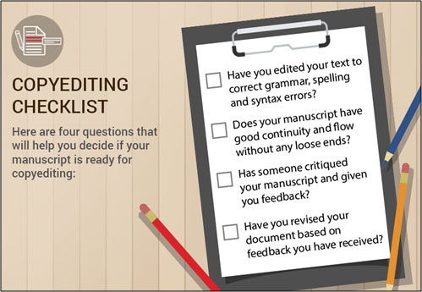
SUMMARY
Copy editing is the thorough examination of the mechanics of manuscript
It may question the credibility and validity of your journal
Copy editor doesn't need to be subject specialist
Checklist needs to be followed

Slide 32
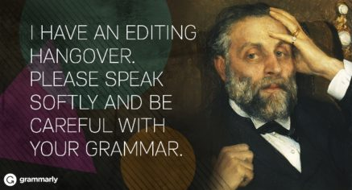
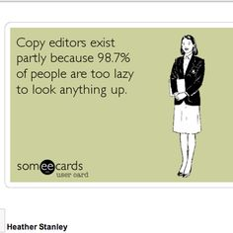
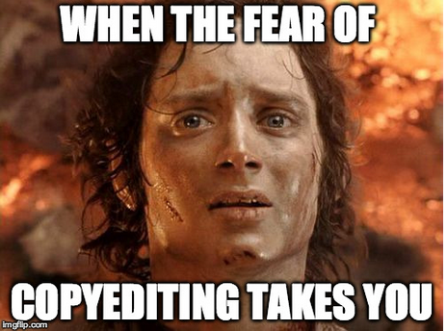

Slide 33
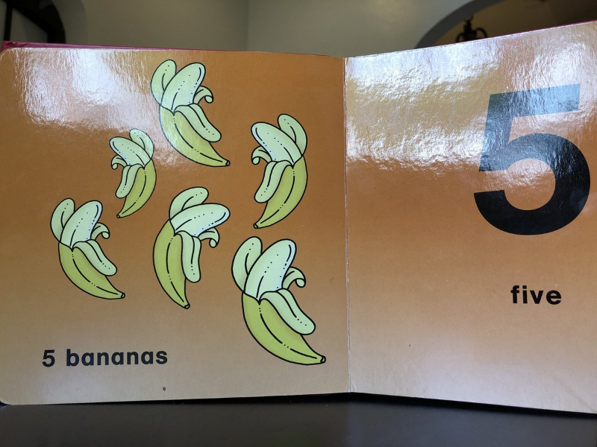

Slide 34
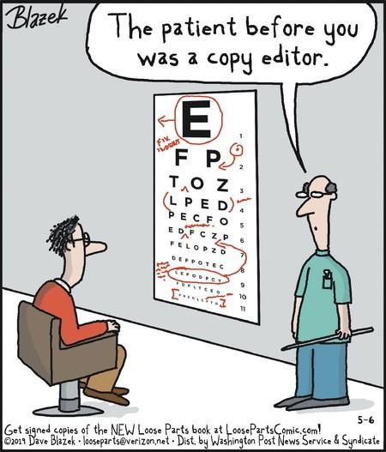
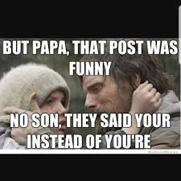

Slide 35
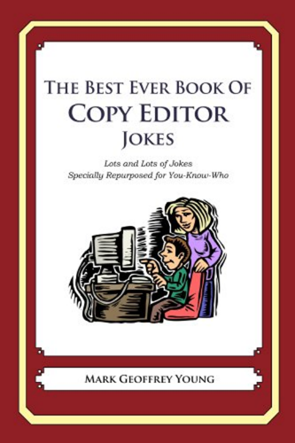
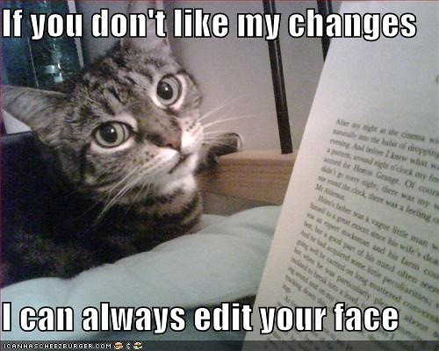

Slide 36
THANK YOU

