Slide 2
RELAtIONSHIPS

Slide 3
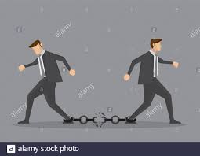
GOOD &BAD RELATIONSHIPS

Slide 4
EDITOR –AUTHOR RELATIONSHIP

Slide 5
WHO IS AN EDITOR
WHO IS AN AUTHOR
CHARACTERISTICS AND QUALITES OF A GOOD EDITOR
CHARACTERISTICS AND QUALITIES OF A GOOD AUTHOR

Slide 6
EDITOR
Steward/chief executive officer of the journal
provides direction
buildS a strong management team
ultimately responsible for what is published in the journal
Expected to review policies related to authorship, peer review, quality control and ethical issues
ensure that the journal’s processes are transparent

Slide 7
editorial content of the journal
make final decisions on manuscripts
manage and organize the editorial office and ensure good working practice
attract authors to submit quality manuscripts to the journal
represent the journal in national and international forums
plan for the future of the journal

Slide 12
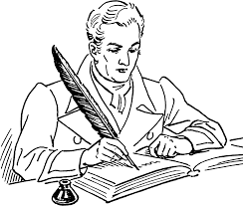
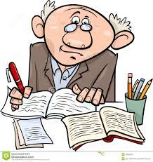
AUTHOR
A person who originated or gave existence to anything.
A person who writes a novel, poem, essay, RESEARCH ARTICLE etc.

Slide 14
AUTHOR IS FAMILIAR WITH WRITING EDITOR IS PROFESSIONAL AT WRITING

Slide 15
EDITOR-AUTHOR RELATIONSHIP

Slide 16
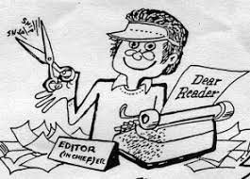
editor
prepares a final copy of something
takES out extra WORDS
fixing errors.
A person who edits written material
for publication.

Slide 17
Editor is final authority
Editor is the final authhhority
Author is final authority

Slide 20
Editor Author Relationship
Should be based on TRUST.
MUTUAL RESPECT is mandatory.
Works best if both have SAME WAVE LENGTH.
No place for EGOS & personal attachments.
The only FOCUS IS ,THE WORK itself.
PROFESSIONAL BOUNDARIES must be maintained by both.

Slide 21
AUTHORS
The editor SHOUD prepare and publish clear instructions for authors, and establish effective mechanisms for communication and interaction
fair, courteous and honest
PROMPT communication
ensure that they maintain high ethical standards
COFIDENTIALITY
authors are expected to be prompt and polite in their communications, and to ensure that they adhere to the ethical standards of the journal

Slide 22
CONFLICT RESOLUTION
ENSURE EVIDENCE FOR DECISIONS
Punctuality
Professionalism
Honesty
Politeness
Concentration on detail and clarity.

Slide 23
SUBMISSION SUPPORT
journal must provide up-to-date information for authors on how to submit their manuscripts, and also provide them with appropriate forms, such as declaration of authorship, copyright form, ethical clearance, etc.
GOOD SERVICE TO AUTHORS –FAST AND EFFICIENT MANUSCRIPT PROCESSING
MINIMIZE PROCESSING AND PUBLICATION LAGS

Slide 24
KEY POINTS
Efficient manuscript processing
Regular communication
Fast time from submission to decision
Fast time from acceptance to publication

Slide 25
SUPPORTING AUTHORS
Helpful guides on how to write and submit
Personal assistance and advice
Good feedback on submitted papers
Have a transparent policy/process for dealing with problems
Do not over-react to problems
COFLICTS TO BE RESOLVED AMICABLY
PROCESS FOR AUTHOR APPEALS (OMBUDSPERSON)

Slide 26
GOOD RELATION
Editing should be a collaborative process based on mutual respect.
The editor should respect the author's expertise and passion.
The author should respect the editor's expertise and passion.

Slide 28
AUTHOR RULES FOR GOOD RELATIONSHIP
Be intentional with communication.
Say thanks.
Don’t fight about revisions.
Be your own fact-checker (and proofreader).
Be a quality writer.
Be open to feedback.

Slide 29
EDITOR RULES FOR GOOD RELATIONSHIP
Be reasonable, CARE FOR TIME.
Answer questions (and follow-ups) promptly.
Don’t expect to get out of revisions.
Do not consider yourself as final authority.

Slide 30
BE KIND TO EACH OTHER

Slide 31
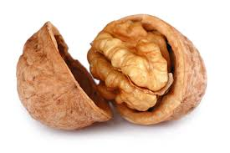
IN THE NUT SHELL
“SYMBIOTIC RELATIONSHIP”
Authors cannot publish if editors do not edit similarly EDITORS CANNOT POLISH IF AUTHORS DO NOT WRITE.

