Slide 1
Systematic Review
Dr. Sadaf Iftikhar

Slide 2
What is Systematic Review (SR)?
Cochrane Collaboration Definition:
“A comprehensive high-level summary of primary research on a specific research question that attempts to identify, select, synthesize, and appraise all high quality evidence relevant to the question.”

Slide 3
What is Systematic Review (SR)?
SRs present a synthesis of findings from multiple studies – can be quantitative or qualitative
Synthesizing results from larger and smaller studies provide valid and reliable conclusions that can inform future research studies, practice, or policy

Slide 4
What is Systematic Review (SR)?
Address a clearly defined question
Characterized by being objective, transparent, and replicable
Orderly steps are carried out in a way that avoids bias and allows for peer review and independent verification

Slide 5
What is Systematic Review (SR)?
Collapse large amount of information into a manageable usable form
Diminish bias by adhering to the systematic process
Allow for increased generalizability/ transferability of findings
Increase confidence in conclusions
Lend a format for ongoing evidence updates

Slide 6
What is NOT a Systematic Review
Literature reviews are a general exploration of literature without adhering to a systematic process
Though often used interchangeably meta-analyses are different from SRs
(Meta-analyses use statistics to evaluate pooled data from single studies and don’t mandate comprehensive inclusion of all relevant studies; therefore, not all meta-analyses are SRs)

Slide 8
Why write a Systematic Review?
Evidence-based care utilizes available literature to guide clinical decision-making and assess strength of evidence
From the Global Evidence Summit 2017:
Data is NOT evidence
Evidence = data + protocol + analysis
SRs critically appraise and synthesize best evidence to provide conclusion statements that inform protocols

Slide 9
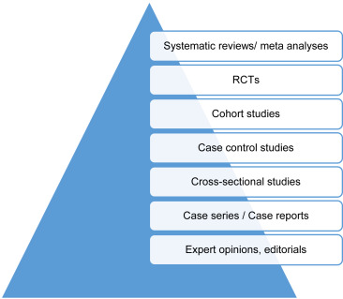
Why write a Systematic Review?
SRs of high-quality RCTs are at the pinnacle of the evidence hierarchy

Slide 10
Tool for SRs
PRISMA – Preferred Reporting Items for Systematic reviews and Meta-Analyses
27-item checklist released in 2009
Aiming to improve review quality
Included as integral component to the EQUATOR network - Enhancing the QUAlity and Transparency Of health Research (Initiative to improve quality of published research)

Slide 12
PRISMA Flow Diagram

Slide 13
8-step Systematic Review Process

Slide 14
8-step Systematic Review Process
1. Check for existing reviews/ protocols Amendment or refinement of the question is needed if a SR has already been conducted
2. Formulate a specific research question that is clear and focused. Use the PICO or PICo tool

Slide 15
PICO – For Quantitative SR
P | I | C | O
Population or Problem | Intervention or Exposure | Comparison | Outcome
What are the characteristics of the Population or patient? What is the Problem, condition or disease you are interested in? | How do you wish to Intervene - what do you want to do with this patient - treat, diagnose, observe, etc.? | What is the Comparison or alternative to the intervention - placebo, different drug or therapy, surgery, etc.? | What are the possible Outcomes - morbidity, death, complications, etc.?

Slide 16
PICo – For Qualitative SR
P | I | Co
Population or Problem | Interest | Context
What are the characteristics of the Population or the patient? What is the Problem, condition or disease you are interested in? | Interest relates to a defined event, activity, experience or process | Context is the setting or distinct characteristics

Slide 17
8-step Systematic Review Process
3. Develop and register your protocol, including the rationale for the review, and eligibility criteria
4. Design a robust search strategy that is explicit and reproducible
5. Conduct a comprehensive search of the literature by searching the relevant databases and other sources

Slide 18
8-step Systematic Review Process
6. Select and critically appraise the quality of included studies
7. Extract relevant data from individual studies and use established methods to synthesize the data
8. Interpret the results and prepare a comprehensive report on all aspects of SR. Present the findings so that they can be translated into clinical practice

