Slide 1
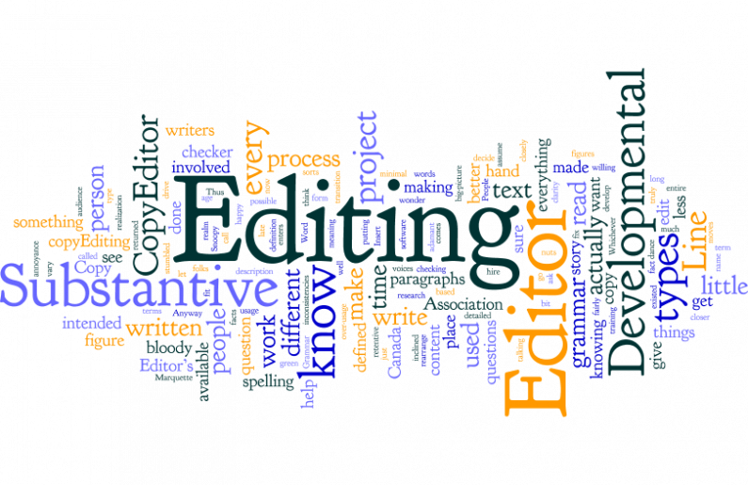
Editing for Medical Journals
Dr SUHAIL NIAZI
Assistant Professor
Kemu / mhl

Slide 2
What is editing?
Carefully reviewing material before it is published
Suggesting or making changes to improve it

Slide 3
Success of a journal depends on publication of well-written, well- organized i.e. high quality material.
Editing is to ensure that all material for publication is presented to
the highest standard and conforms with the journal’s style

Slide 4
Medical editing
Editing involves eliminating spelling, grammar and punctation errors as well as ensuring that your writing is clear and precise.
It reduces awkward phrasing, biased language and awkward jargon as well as making sure that the data used is consistent.

Slide 5
Where used
Books
Articles
Dissertations

Slide 6
Learning objectives
Types of editing
How do they work together

Slide 7
EDITING: A Complex process
Critical part of process Rough draft to Final Version
Different Types – 5 Major types
1. Developmental, Substantive or Content Editing
2. Structural Editing
3. Copy Editing
4. Line Editing
5. Mechanical Editing
Overlaps

Slide 9
Questions to ask in editing
Who is your audience?
What are the key messages?
What does your audience want to know?
Where would your audience most logically look for this information?
What is the logical flow of the information?
What pieces of the information go best together?
How can the audience be led through the information with headings?
Should the information be presented in a different style or format?

Slide 11
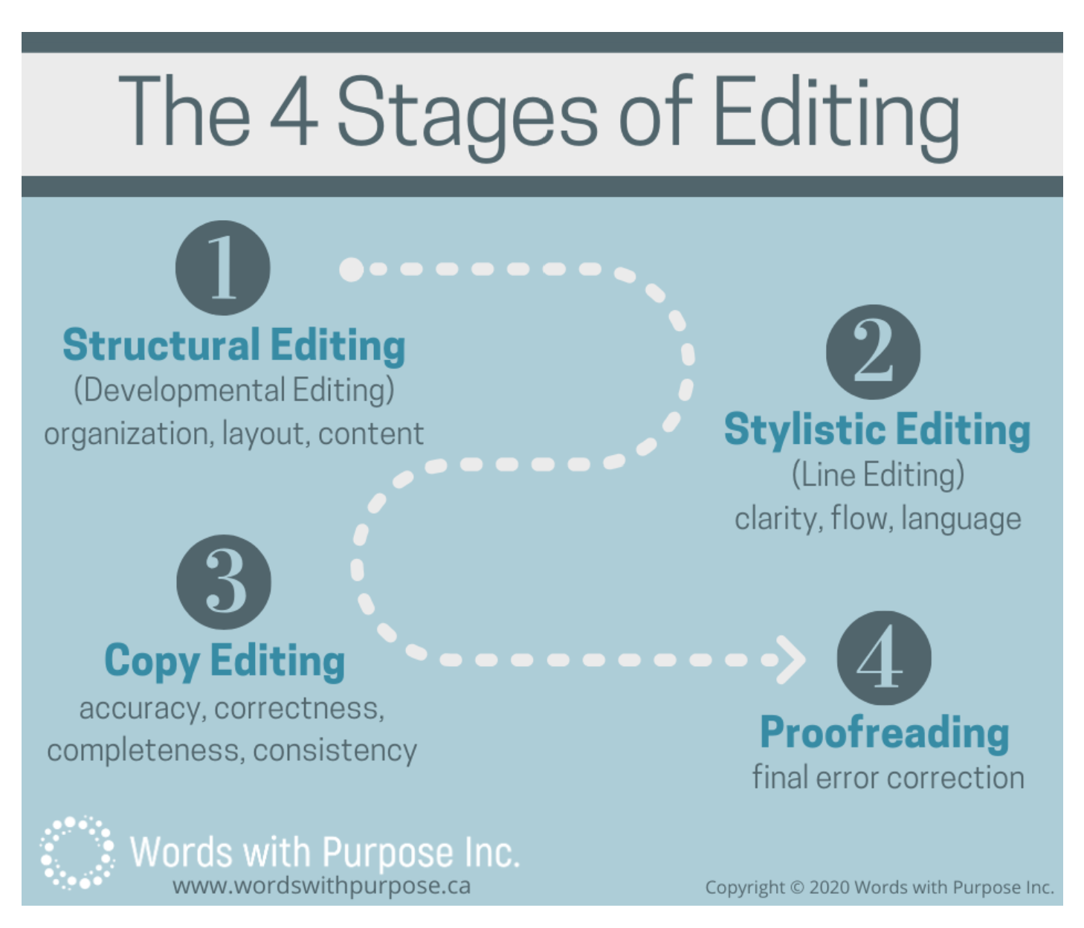

Slide 13
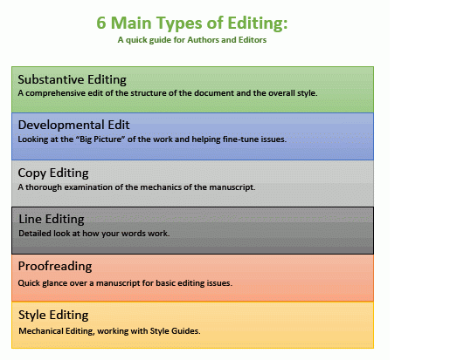

Slide 14
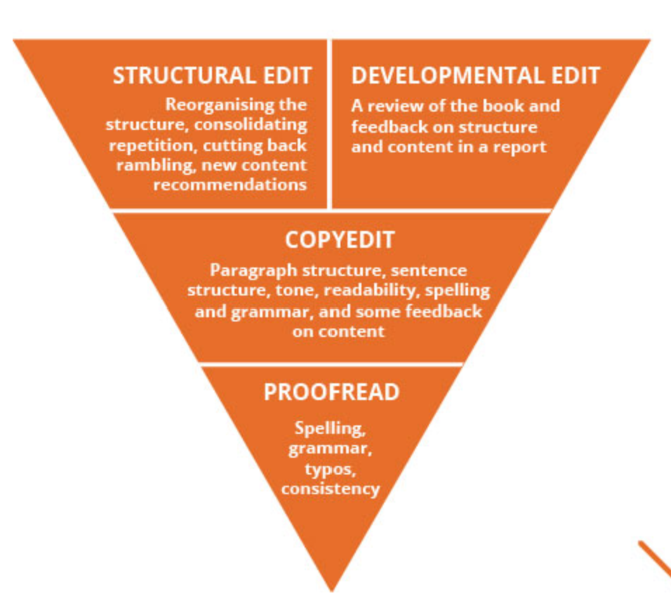

Slide 15
Developmental/ Substanstive/ Structural/ Conceptual Editing Manuscript appraisal
- Sets the foundation
- Non fictional writing
Focus on content & Structure
Moving chapters around
Adding headings
Deleting sections
Modifying visual elements
Creating new content

Slide 16
Developmental Editing
- First step
- Looks deeply at the content
Consider a bigger picture
Question if contents of paper make sense?
Tone, Quality, Flows well?
Ideas clearly developed & articulated
Any major logical holes or flaws?
Leave notes & recommend big changes
May delete sections or suggest adding more information

Slide 17
Developmental Editing
Three principal sections:
Structure is the container that holds the story, including its length, order and pacing
Narrative is all of the story elements, such as characters, major scenes, continuity, and authenticity
Language includes dialogue, physical description, sensory information, and sentence structure

Slide 18
Importance of Developmental Editing
Writers often struggle with keeping perspective on their own work
They’re too close to it to know what does or doesn’t work for another reader
Writers unconsciously fill in the narrative gaps with their own knowledge of the book
They can be enthralled with their subject, without considering general interest
“It’s about showing the writer what works.”

Slide 19
What it is and isn’t
It denotes significant structuring or restructuring of the manuscript’s discourse
It is not line by line correction

Slide 20
Developmental Editing Process
There are a few things that all editors should be clear when considering a developmental edit:
Be open minded
Be prepared to suggest rewrites
Focus on the big picture
Practice patience

Slide 21
Focus on the big picture
Developmental editing is comprehensive, and it’s easy to get distracted by the endless small details you want to nit-pick, but there’s plenty of time to do that during the line editing phase
When it comes to developmental editing, the focus should be more about the bigger ideas, and how all the main pieces of the story work together first

Slide 22
be open minded
Although a necessary step, some authors find it difficult to receive critical feedback on their writing. Sometimes an editor’s critique will involve cutting out particular moments within the story that authors don’t necessarily want to lose.
However, if you find yourself constantly at odds with authors over their work, it’s possible your technique might not be the right fit for you

Slide 23
Be prepared to suggest rewrite
A developmental editor may completely shake up the foundation of the manuscript, resulting in a substantial rewrite
You may have to reconsider certain plot elements, characters, settings, or conversations that aren’t telling the story the way it should ideally be

Slide 24
Practice patience
Addressing one round of notes doesn’t mean you’re done, or even close to it.
This editing process is the most involved, and oftentimes changing one part of a manuscript can result in a necessary change elsewhere.
It’s worth the time to ensure the manuscript is telling the required story the way you want, and help author stay on track!!

Slide 25
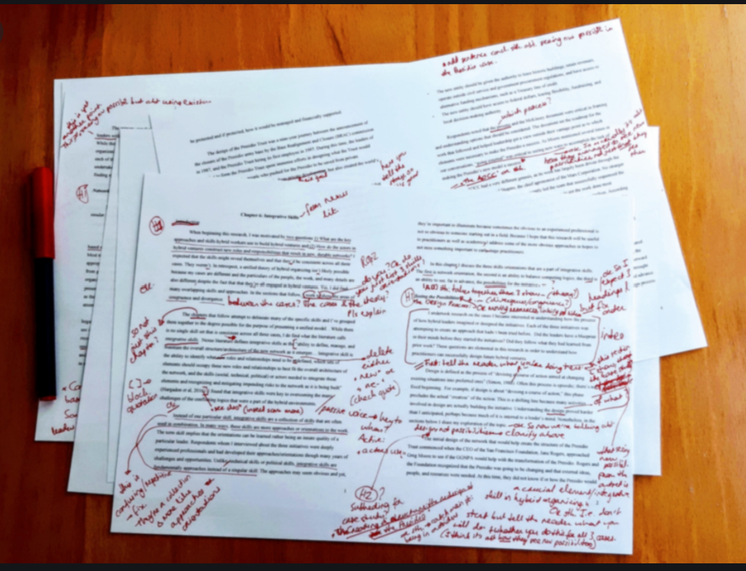

Slide 26
let’s look at what structural editing actualy is
It’s essentially about looking at the big picture, evaluating the manuscript as a whole and analysing how well its constituent parts contribute to the central message or narrative. Whereas the copyeditor takes a micro view, drilling into the detail, the structural editor goes macro and asks, ‘Does this work as a comprehensive article, book, journal??’
To make sure the audience can quickly and easily grasp the information that is being presented in a logical and intuitive structure.

Slide 27
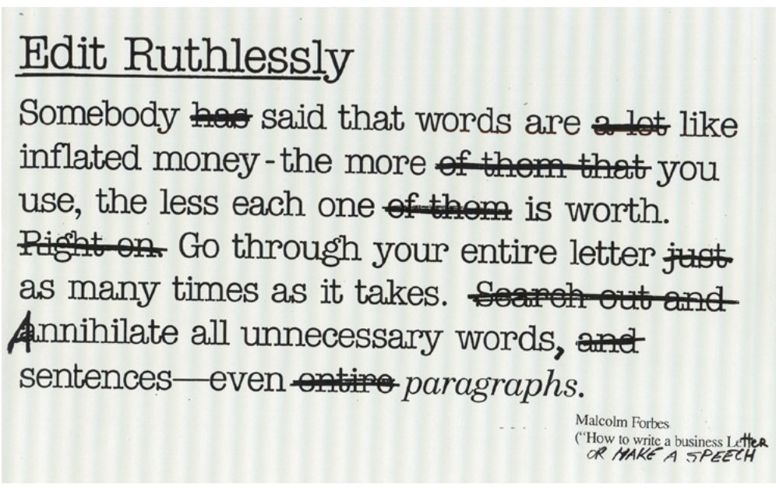

Slide 28
This level of editing involves a structural review of:
Content
Language and style
Presentation clarity and document flow cohesion
Consistent use of voice and tone throughout a document

Slide 29
Structural editing evaluates whether the content of your document will be comprehensible to the reader and uses the appropriate
Tone
Style
Language
terminology

Slide 30
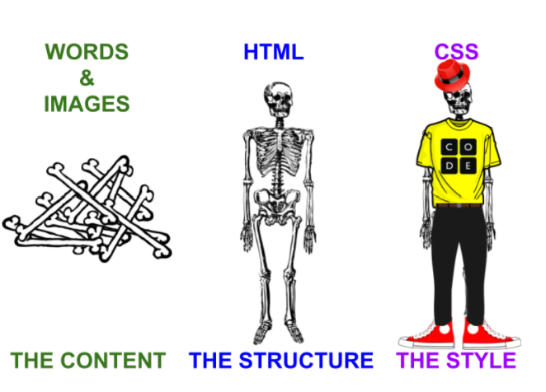

Slide 31
Assessment
B1 Assess the overall organization and content of the material to determine its suitability for the intended audience, medium, market, and purpose.

Slide 32
Organization
B2 Reorganize material to achieve a coherent structure and sequence, a logical progression of ideas, and a narrative or expository flow and shape appropriate to the audience, medium, and purpose, keeping in mind that the medium often determines organization (e.g., the inverted pyramid structure of a news story, the chapter arrangement of a book, the linked structure of a website). If necessary, create a new outline or site map and either follow it or recommend it be followed.

Slide 33
B3 If necessary, recommend headings and navigation aids to clarify or highlight organization of material.
B4 Recommend or implement the most effective positioning of auxiliary textual material (e.g., sidebars and pull quotes).
B5 Determine and either indicate or implement the most effective positioning of all visual elements.
B6 Revise, cut, or expand material, or suggest such changes, to meet length requirements.

Slide 34
Content
B7 Identify and either recommend or make appropriate deletions (e.g., to remove repetitive, irrelevant, or otherwise superfluous material) and additions (e.g., to fill gaps in content or strengthen transitions between sections) in both text and visual elements.
B8 Recognize and either query or resolve instances of questionable accuracy, inadequate research, imbalanced content, and lack of focus.
B9 Recognize and recast material that would be better presented in another form (e.g., number-laden text as a table, descriptive material as a diagram or infographic, a long series of points as a list, a lengthy digression as an appendix).

Slide 35
B10 Select, create, or secure appropriate visual elements (e.g., images, video, figures), if necessary, in keeping with the requirements and constraints of the publication (e.g., budget, schedule, format, medium). Determine the appropriate content and length of captions, titles, and alt text.
B11 Identify, create, or secure appropriate supplementary and reference material (e.g., glossaries, endnotes, links).
B12 If required, create or secure accurate and complete supplemental material (e.g., audio and video, pop-ups, mastheads, front and back material).
B13 Determine whether any permissions are necessary (e.g., for quotations, visual elements, audio). If necessary, obtain these permissions or bring the matter to the attention of the appropriate person.

Slide 36
Communication
B14 Communicate clearly and diplomatically with the author or project supervisor to confirm structure, request clarification of content, and propose or negotiate broad editorial changes.

Slide 38
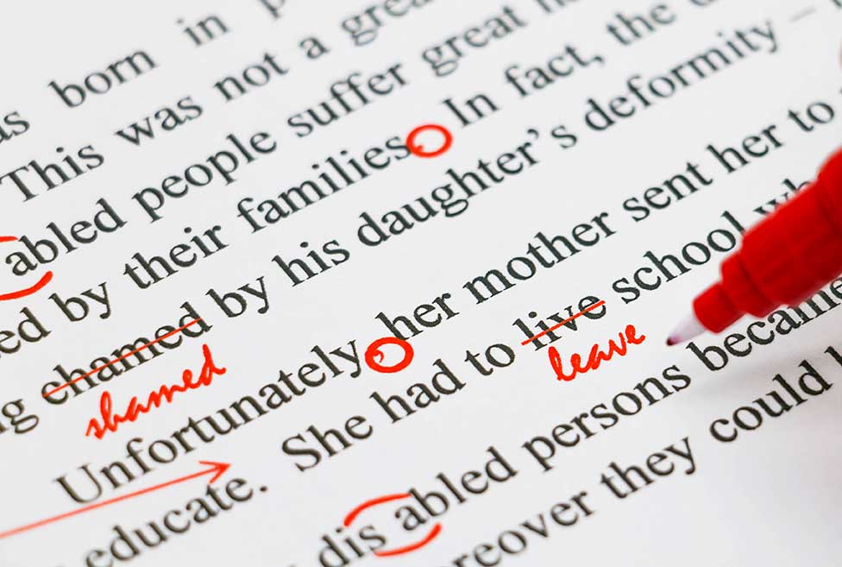
Copy Editing
Process of revising written material to improve readability,
consistency, as well as ensuring the text is free of grammatical
and factual errors.
Editing focuses on the meaning of written content
Copyediting focuses on its technical quality

Slide 39
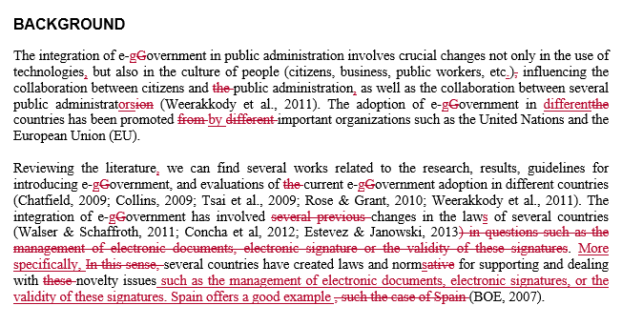
EXAMPLES OF COPYEDITING

Slide 44
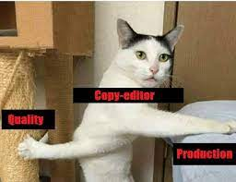
TYPES OF COPY EDITING
Line Editing
Fact-Checking
Rewriting
SEO Copy Editing
Proofreading
Content Refreshing

Slide 46
Line Editing
Process of assessing the piece of work as a whole
Considering it’s clarity, accuracy, tone, consistency, and
overall effectiveness
Fact-Checking
More straightforward type of copy editing
It involves ensuring all facts are accurately and appropriately
attributed according to the publisher’s style requirements

Slide 47
Rewriting
Involves reconstructing a portion or all of a written piece
SEO Copy Editing
For search engine optimization SEO
Creating useful, compelling, and valuable content that targets
specific keywords so that other people will gladly promote it on
social media platforms

Slide 48
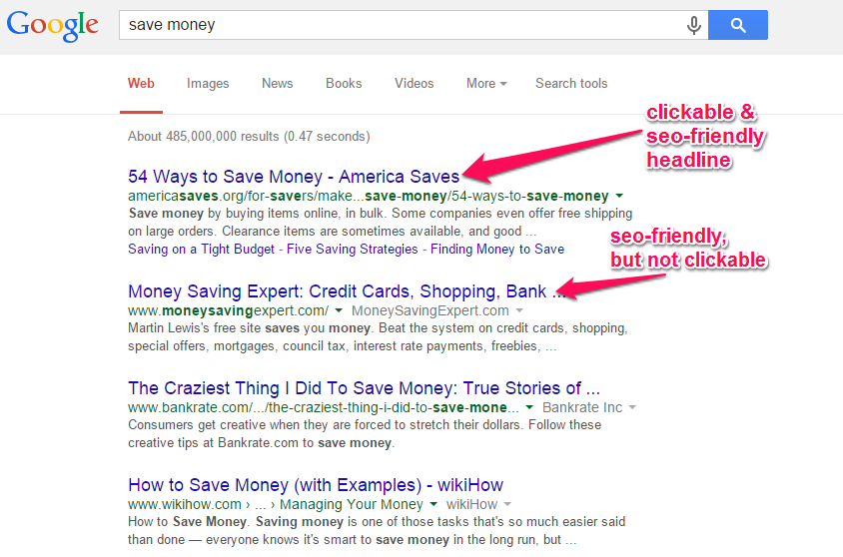

Slide 49
Proofreading
Process of checking grammatical accuracy of written content
Ensuring correct spelling, capitalization, punctuation,
formatting, noun-pronoun agreement, verb usage and
sentence structure
Just one or two errors might cause a reader to question the
credibility and validity of your work

Slide 51
Content Refreshing
Involves a simple content review to check for a stale or
outdated tone of voice, inaccurate or changed information,
and other out-of-date copy
Refreshing digital content also help improve SEO results

Slide 52
Who does Copyediting?
Good command on the language of paper and familiarity with the journal style
Budget constraints
Support staff
Volunteer staff
External companies
Editorial board members/ editor
Always worth trying to secure funding for
this type of editor, whether in-house
or freelance

Slide 53
ROLES & RESPONSIBILITIES
Overlap between the 3 roles: Technical, Language & Copy editors
Many journals employ on one person to undertake all 3 or rely on volunteers
Technical, language and copy editors are frequently not
specialists in the journal discipline

Slide 54
to be continued
Copy, Language and Technical editors are expected to:
Ensure that the correct structure for the corresponding section
of the journal has been followed
Improve the presentation and wording so that the text is easy
to read and understand
Develop and maintain a style sheet concerning spelling, hyphenation, format, etc.

Slide 55
To be continued
Ensure correctness and consistency in the use of terms
Eliminate unnecessary and repeated material, simplify long and
complicated sentences, eliminate unnecessary words
Check that tables and figures are correctly cited in the text
Advise on the selection and effective use of tables and
illustrations

Slide 56
To be continued
Edit tables and figures so that they prove their point and
their information ties with the text
Check all totals and percentages
Ensure that all cross-references are correct and that all
bibliographic citations match the reference list
Check that the references used are not grossly or
overwhelmingly outdated

Slide 57
To be continued
Ensure that the article is complete – that it has the author
addresses, email contact numbers, etc.
Mark up the manuscript or proof with all necessary
instructions for composition or printing

Slide 58
Checklist
Check the format of headings and paragraphs is correct and
appropriate.
Ensure the grammar, spellings and punctuation are correct
and consistent with house style.
Ensure the use of italics, bold and quotes is appropriate and
not excessive.

Slide 59
Ensure units are included where necessary and used correctly
(e.g. SI units).
Check figures and tables referred to in the text are in correct
numerical order.
Check that the number of tables/figures is not excessive and
comparable to the length of the paper.
Check that tables have clear titles and column headings.

Slide 60
Ensure that all abbreviations in tables are explained in the
legend.
Ensure that drawings and photographs are clear and of good
quality and the caption agrees with what the figure shows.
Check that all references in the text are also included in the
reference list in the correct order, and all those in the reference
list are mentioned in the text.

Slide 61
Ensure that all references are in the correct format in line with
journal style.
Mark up the text ready for layout (indicate where figures,
tables, etc., are to appear in the text, add journal information
as required).

Slide 62
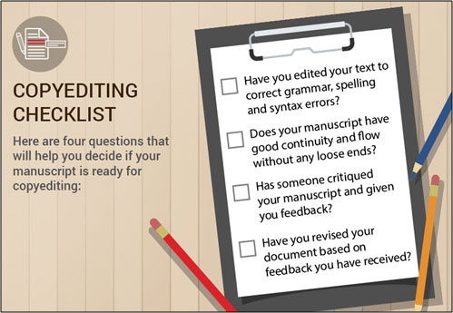
SUMMARY
Copy editing is the thorough examination of the mechanics of manuscript
It may question the credibility and validity of your journal
Copy editor doesn't need to be subject specialist
Checklist needs to be followed

Slide 64
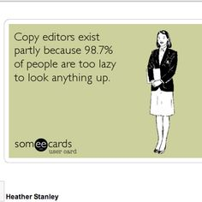
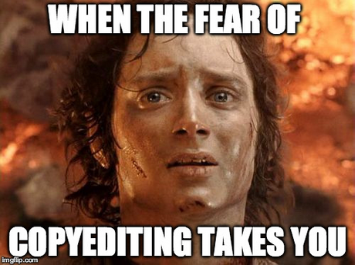

Slide 65
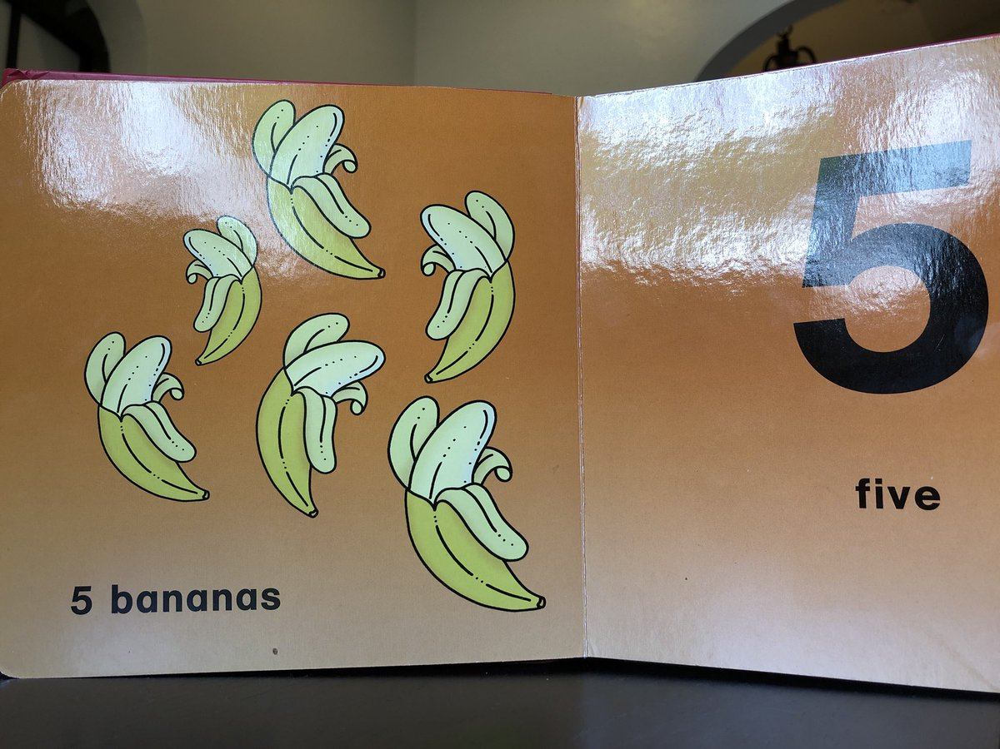

Slide 66
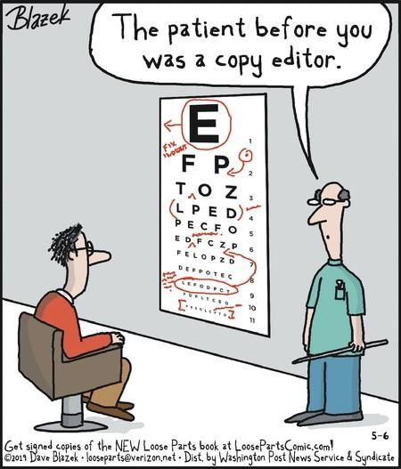
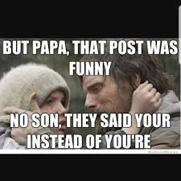

Slide 67
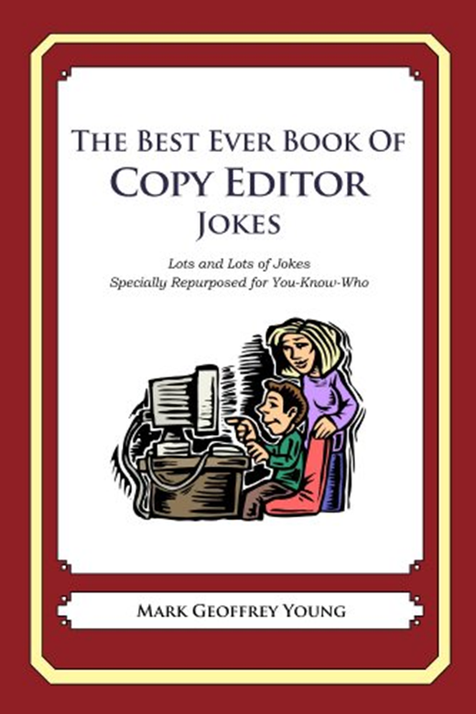
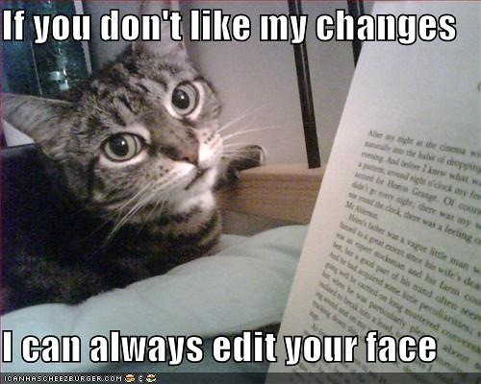

Slide 68
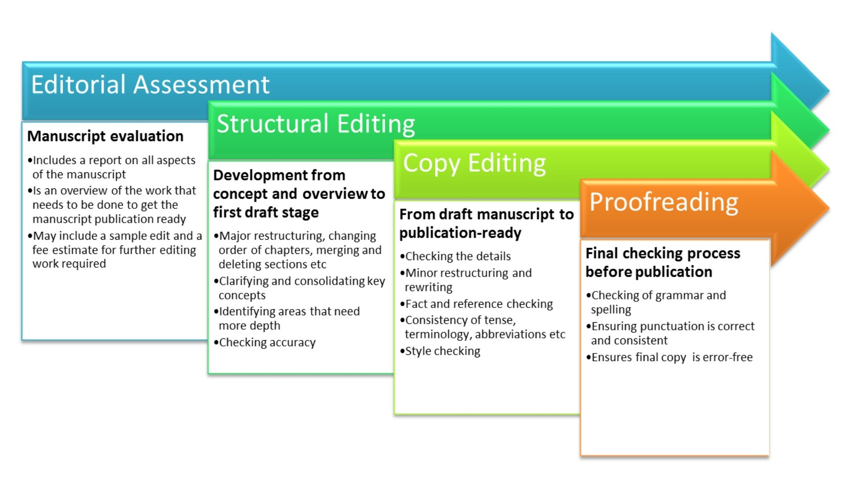

Slide 70
being a good editor
A few years of experience in the publishing industry
Book editing experience with the particular genre.
Compatible with your personality, understand the writing styles, and provide open and honest communication while also respecting author’s vision.
Knowledgeable about the entire publishing process in order to properly guide others

Slide 72
THANK YOU

